Slide 1
General Capabilities

Slide 2
Project Big Bird Tracy, CA
3,800,000 SF 26,000 Tons
Fabrication Group: 700,000 SF, Four locations
Little Rock, AR
Jonesboro, AR
Blytheville, AR
Monroe, LA
AISC-certified
Div. of Lexicon, Inc. –
Construction consortium – fabrication, erection, industrial contracting
54 yrs. in business – since 1968
.52 EMR
$823M / year revenue in 2021

Slide 3
Project Big Bird Tracy, CA
3,800,000 SF 26,000 Tons
120,000 tons/year production capacity, self-perform
Additional 80,000 tons/year capacity through our Subfab Dept.
Bonding: $250M single project, $400M aggregate
Nucor/Vulcraft relationship
Nucor’s largest fabricator customer
Proximity to the mill – next door and 3 hrs. away
Lexicon’s ongoing work inside Nucor’s mills
Leader in robotic fabrication
4 fully robotic beam fit-and-weld production lines
Up to 85% production time-savings

Slide 4
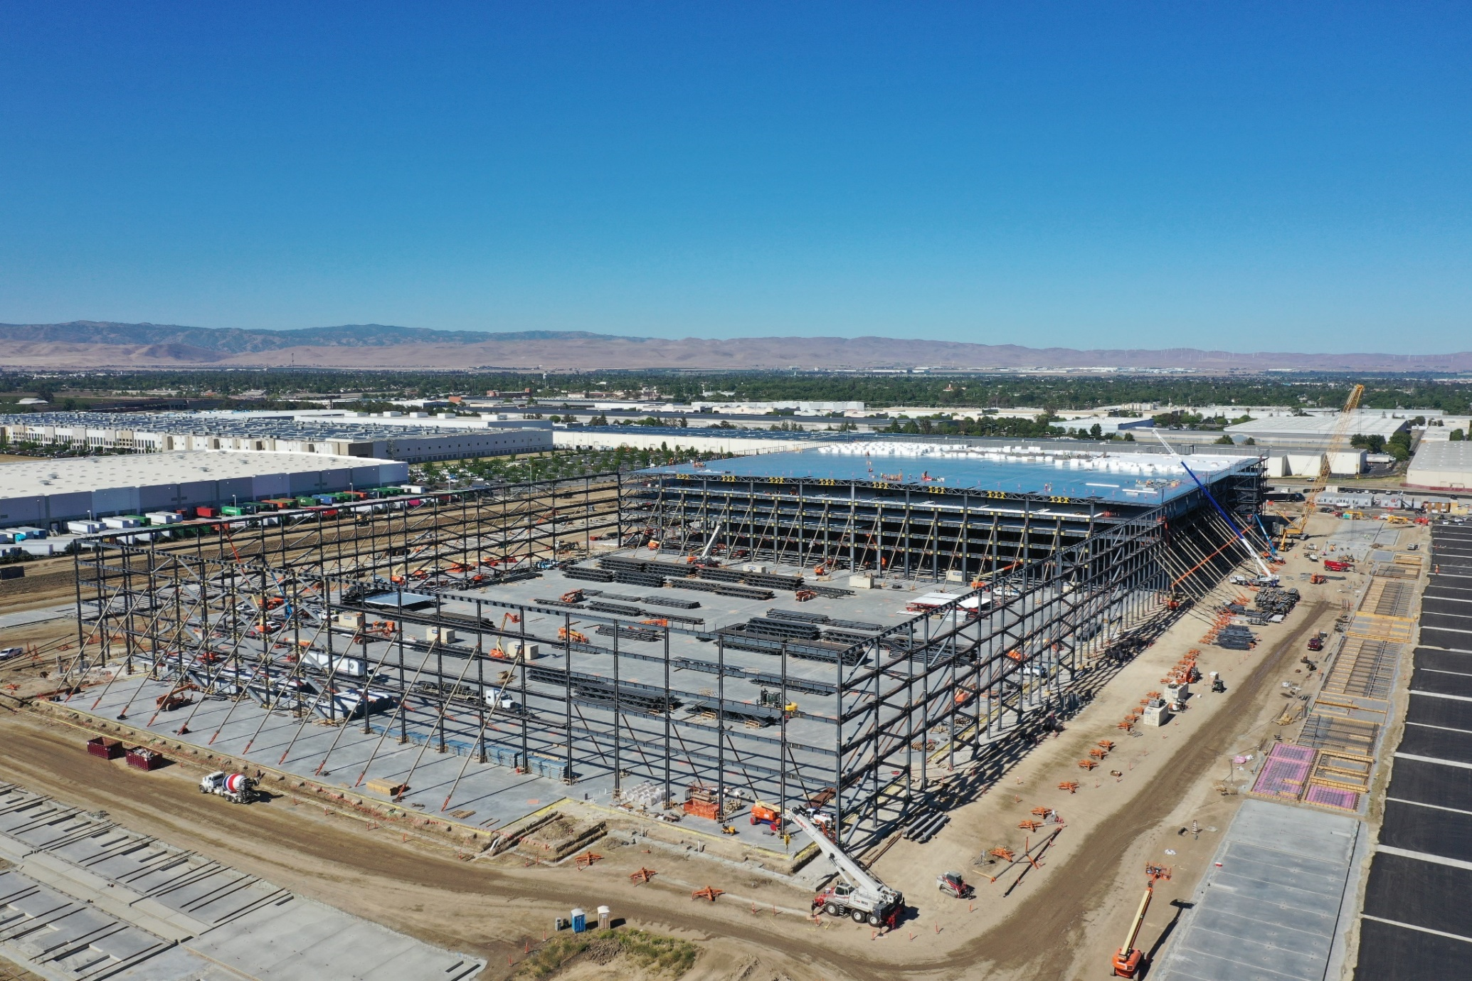
e-commerce fulfillment center, Tracy, CA
3,800,000 SF 26,000 Tons

Slide 5
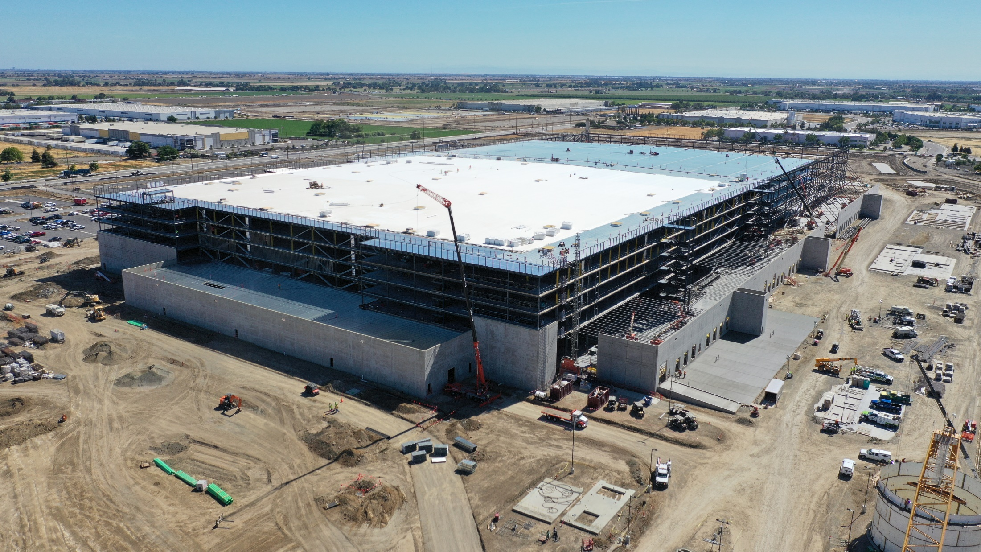
e-commerce fulfillment center, Tracy, CA
3,800,000 SF 26,000 Tons

Slide 6
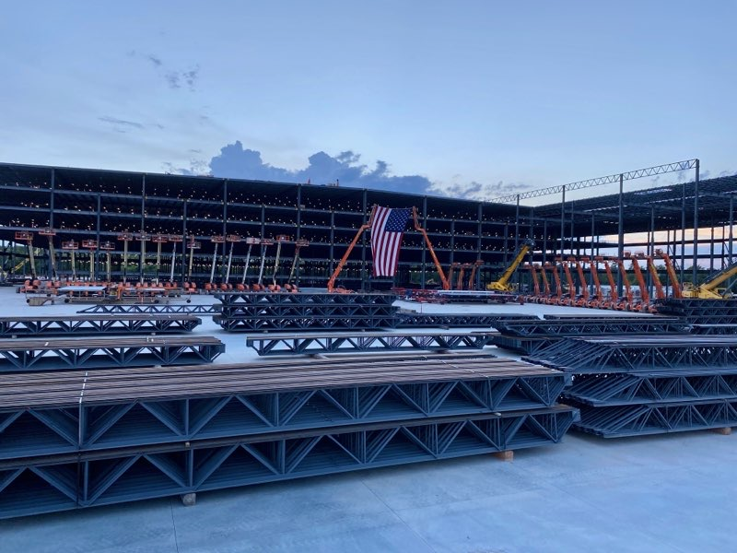
e-commerce fulfillment center, Little Rock, AR
3,800,000 SF 19,500 Tons

Slide 7
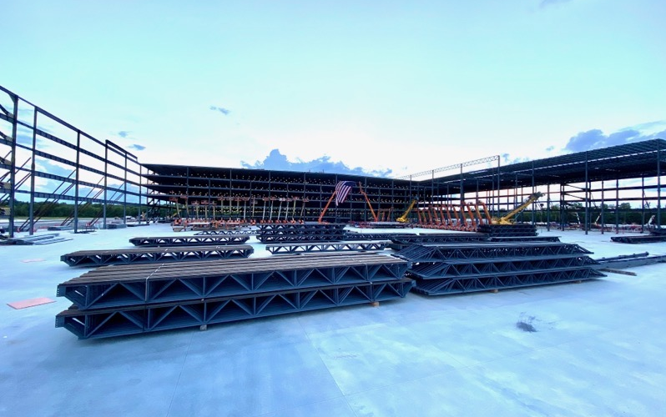
e-commerce fulfillment center, Little Rock, AR
3,800,000 SF 19,500 Tons

Slide 8
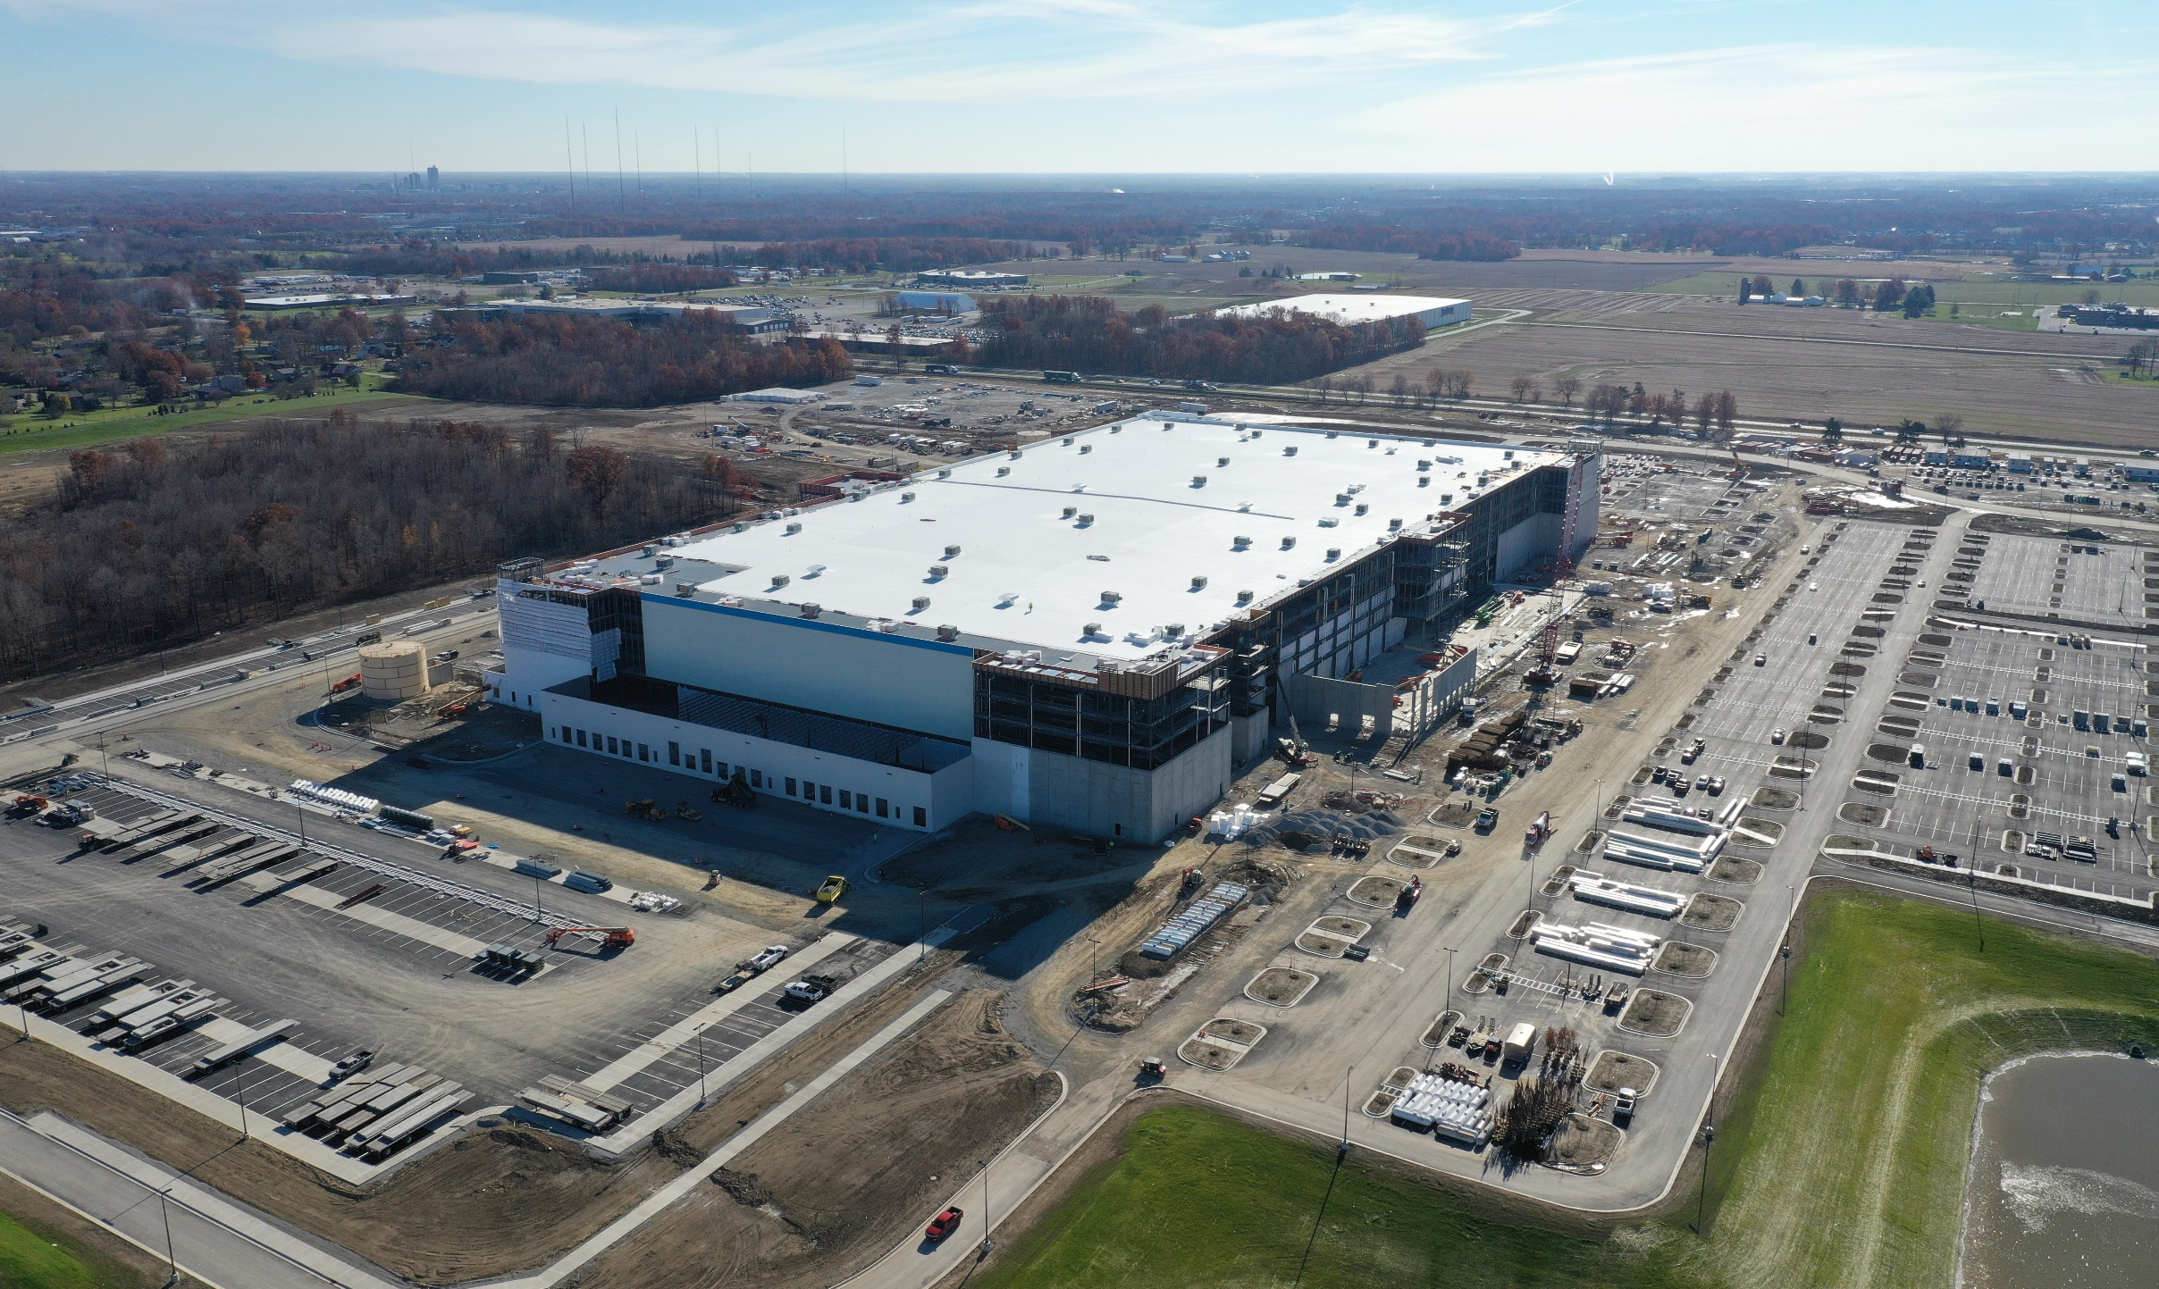
e-commerce fulfillment center, Fort Wayne, IN 3,400,000 SF 20,500 Tons

Slide 9
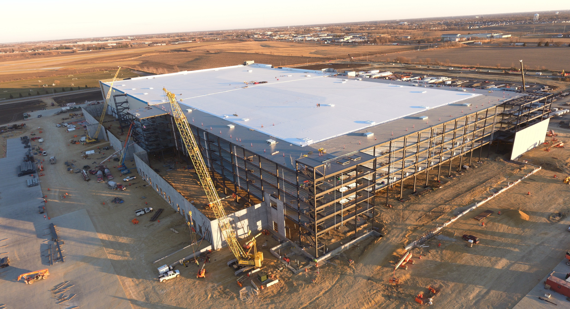
e-commerce fulfillment center, Davenport, IA 3,400,000 SF 22,700 Tons

Slide 10
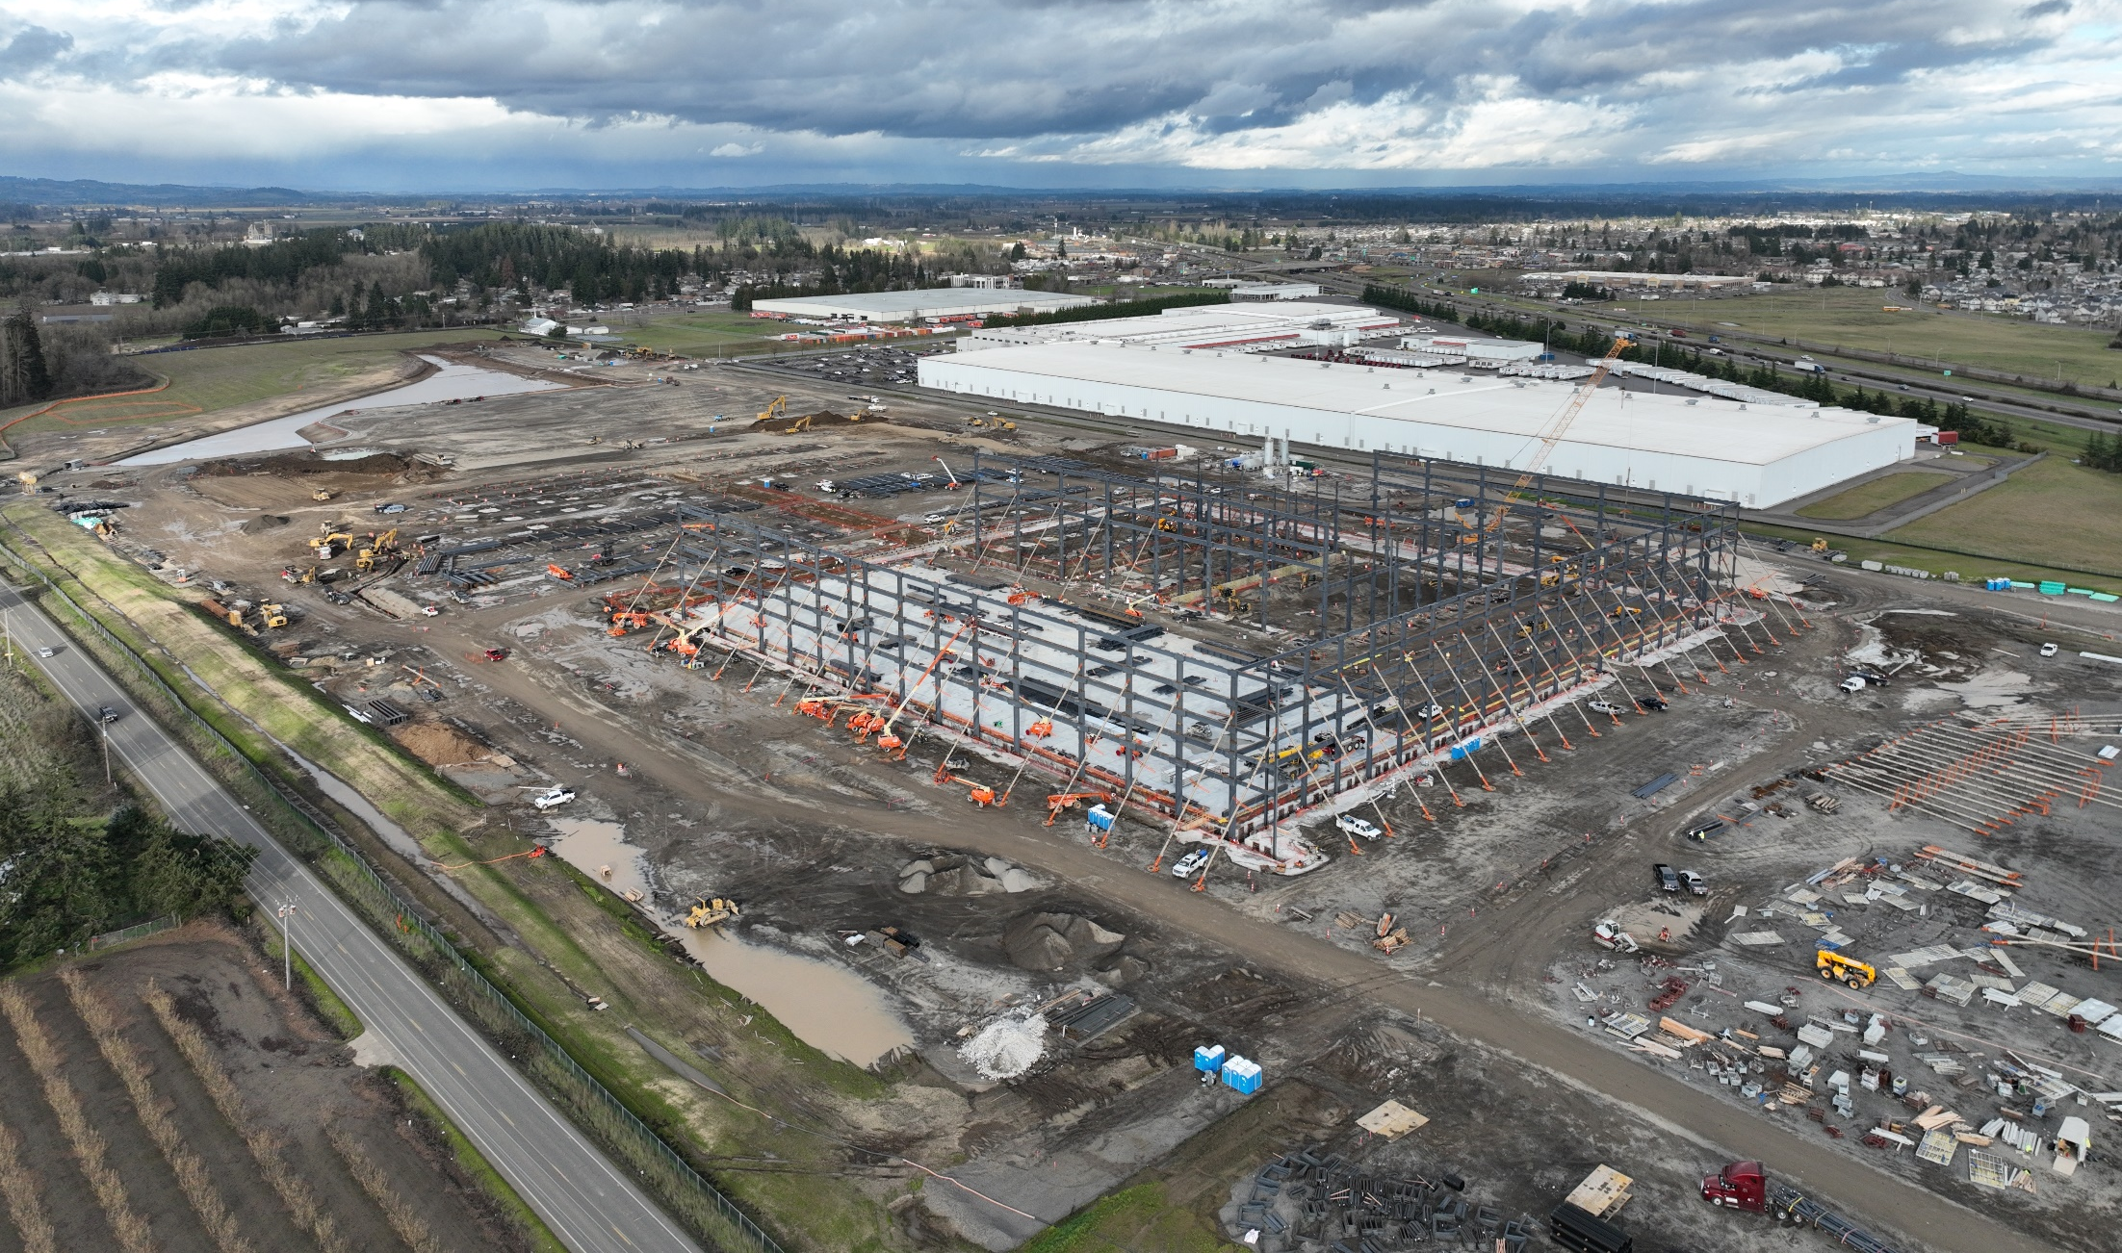
e-commerce fulfillment center, Woodburn, OR 3,800,000 SF 24,200 Tons

Slide 11
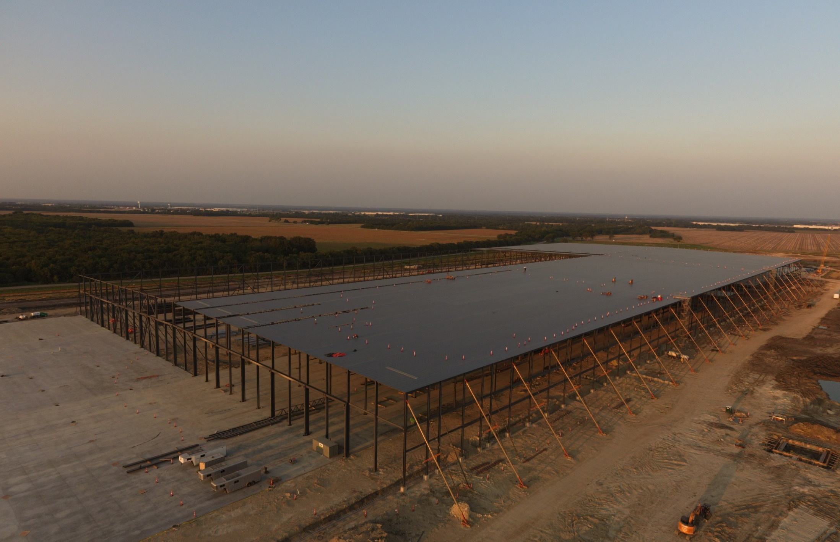
e-commerce fulfillment center, Dallas, TX
2,500,000 SF 13,000 Tons

Slide 12
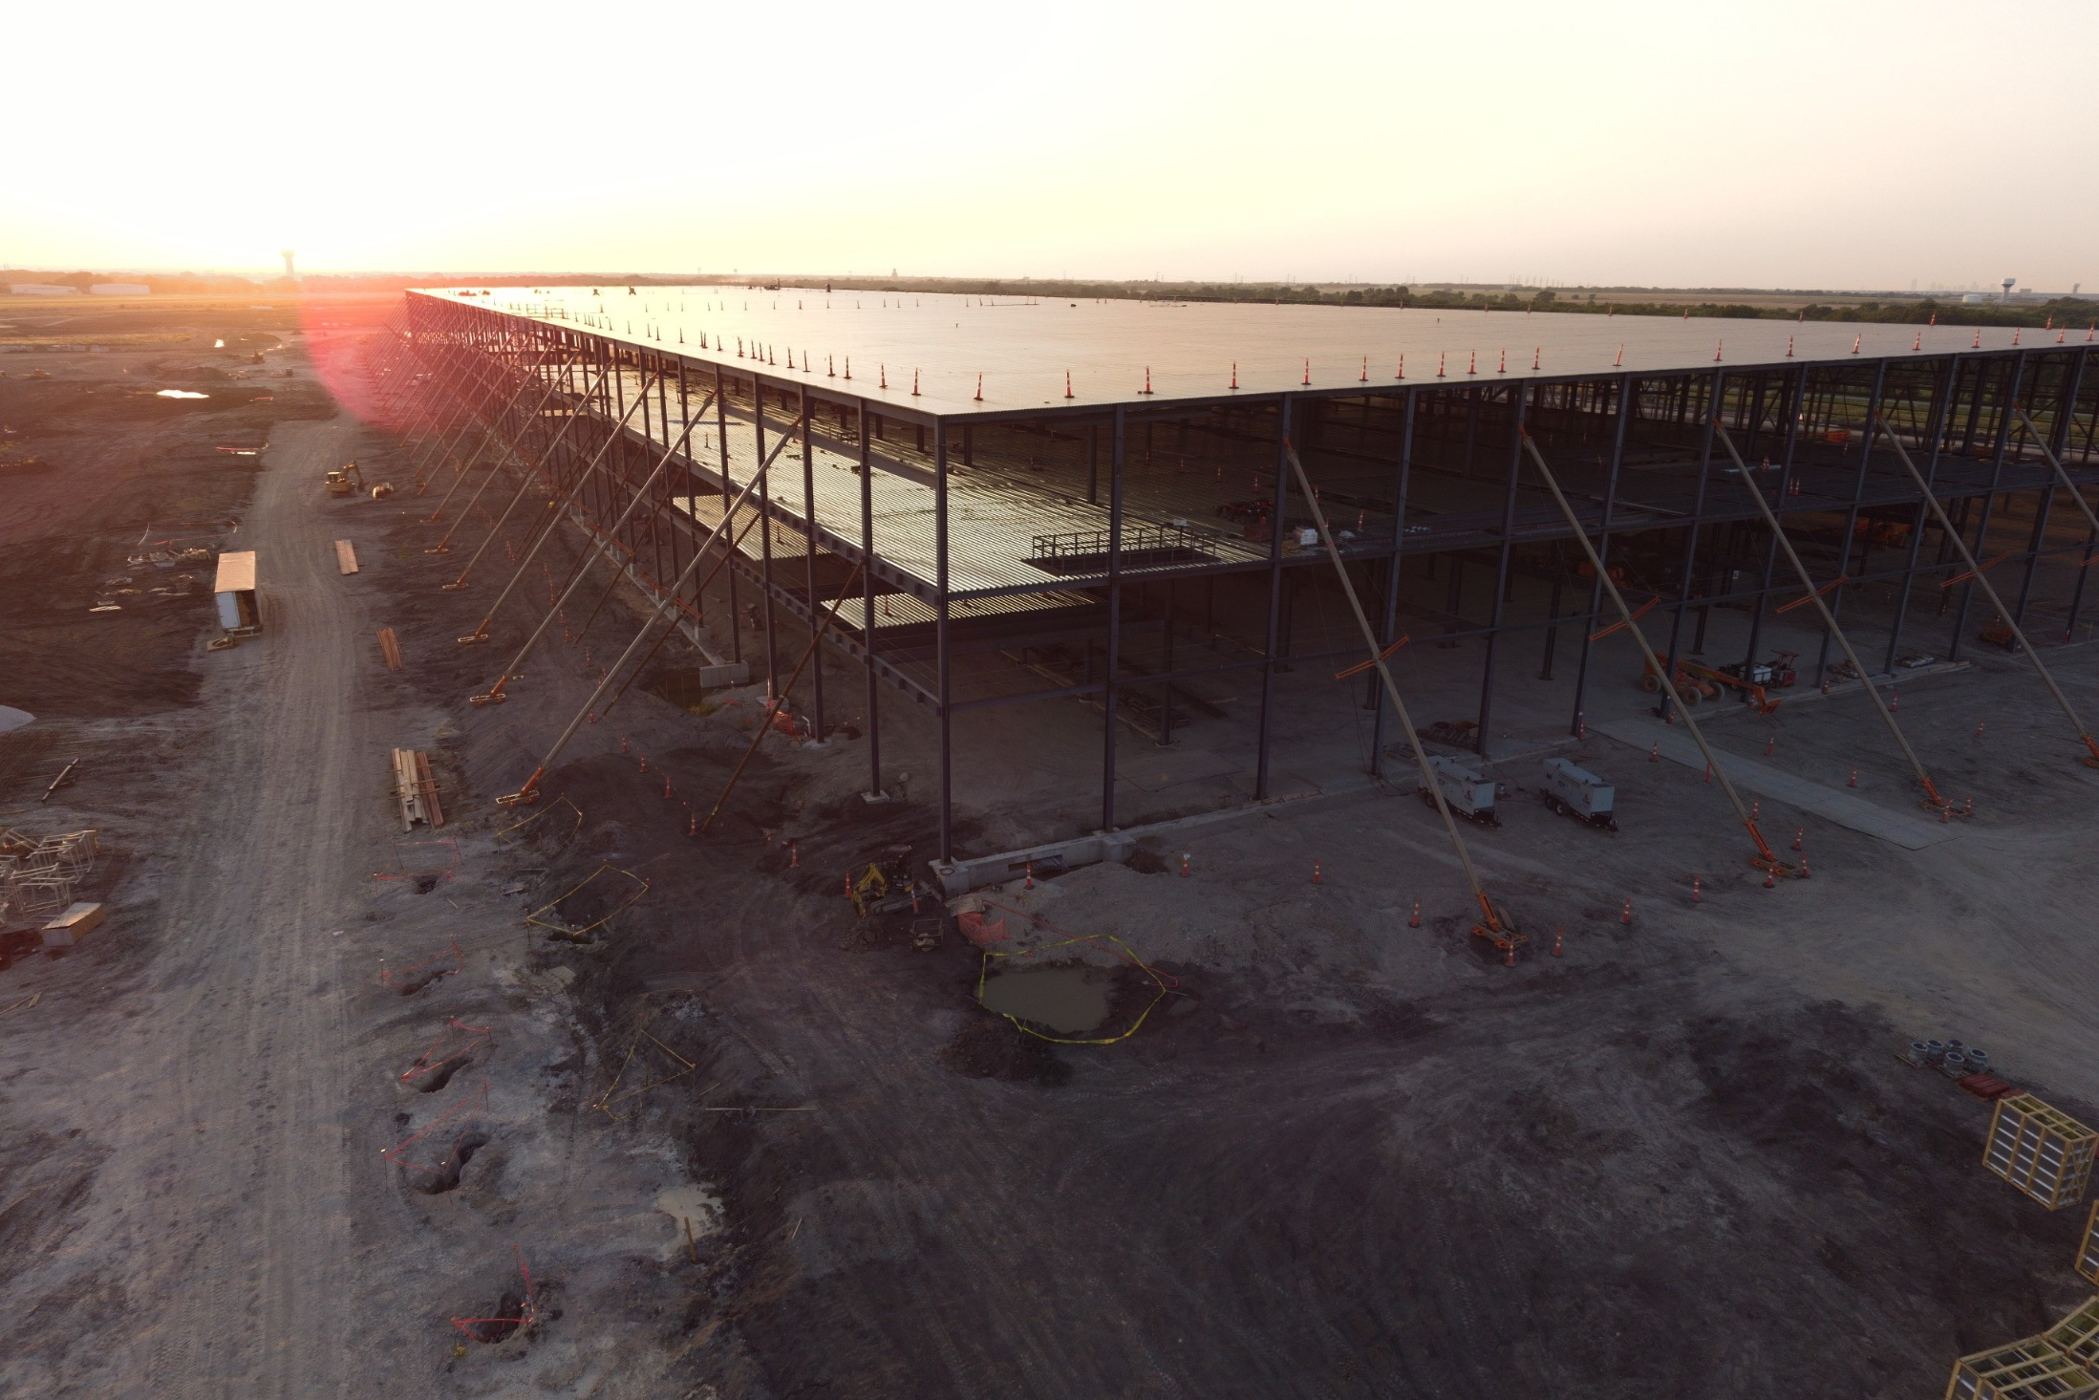
e-commerce fulfillment center, Dallas, TX
2,500,000 SF 13,000 Tons

Slide 13
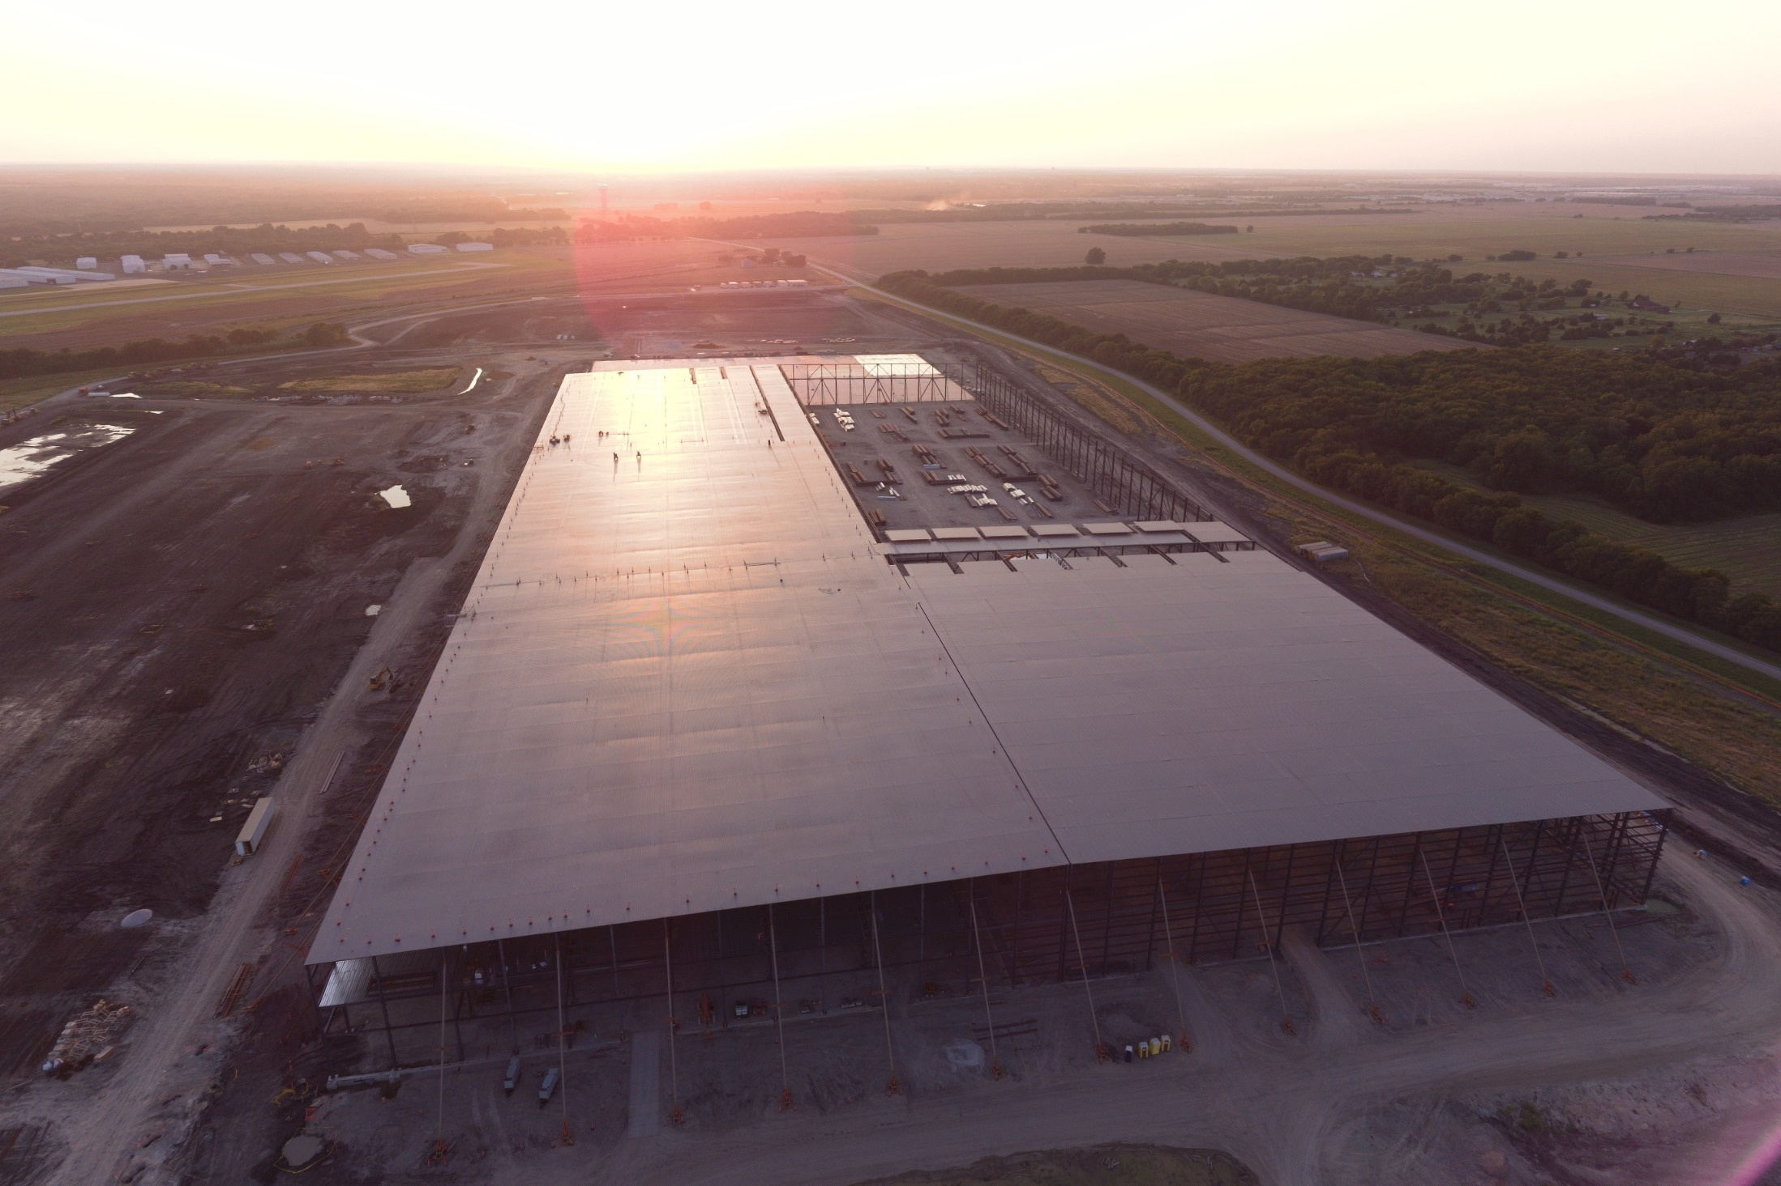
e-commerce fulfillment center, Dallas, TX
2,500,000 SF 13,000 Tons

Slide 14
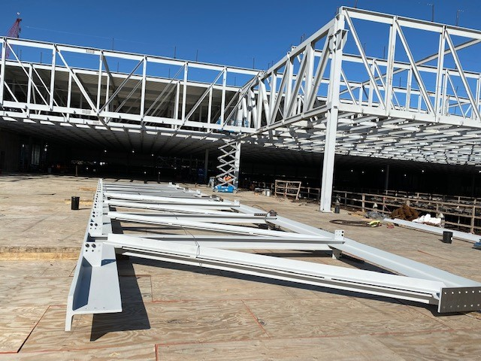
semiconductor plant expansion
Dallas, TX 600,000 SF 11,000 Tons

Slide 15
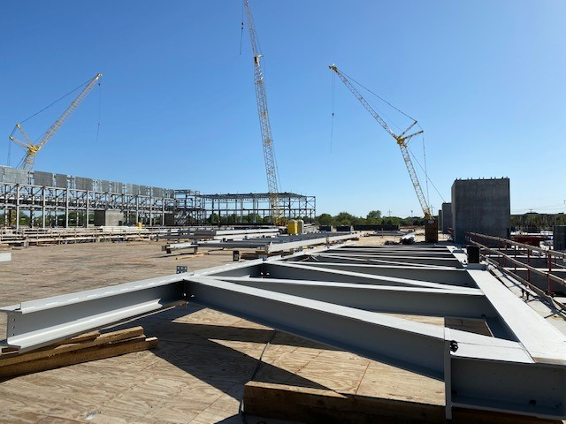
semiconductor plant expansion
Dallas, TX 600,000 SF 11,000 Tons

Slide 16
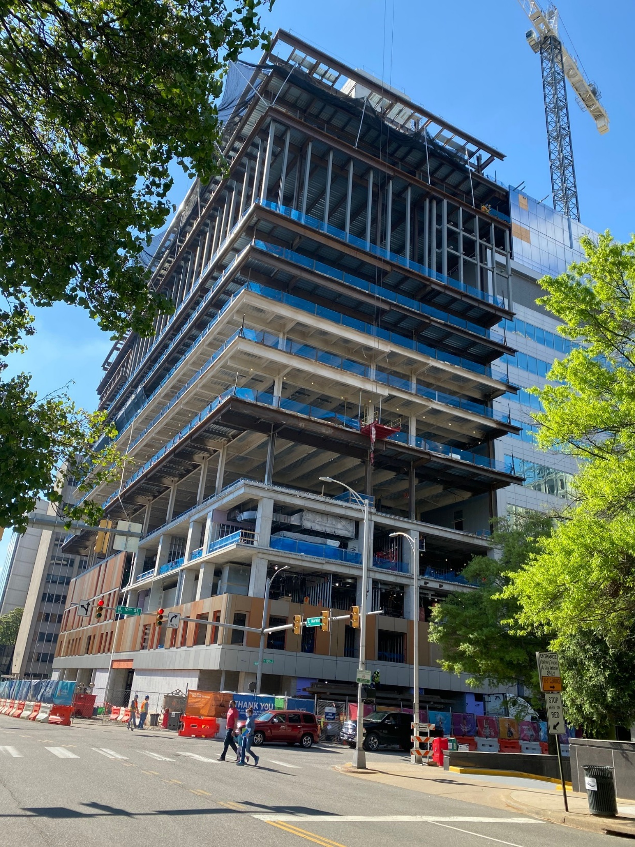
VCU Children’s Hospital
Richmond, VA
3-story vertical expansion of
existing occupied bldg.
13-story adjacent tied-in tower
3,200 Tons

Slide 17
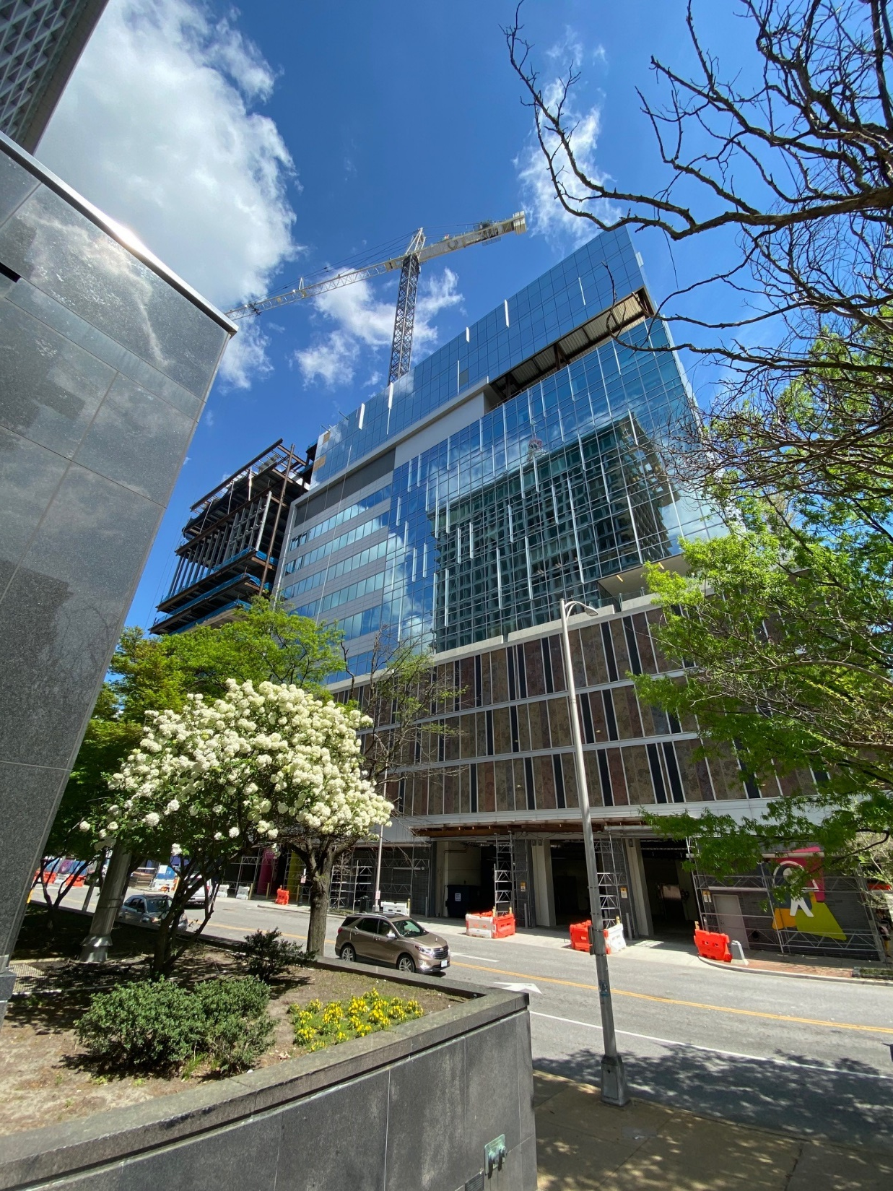
VCU Children’s Hospital
Richmond, VA
3-story vertical expansion of
existing occupied bldg.
13-story adjacent tied-in tower
3,200 Tons

Slide 18
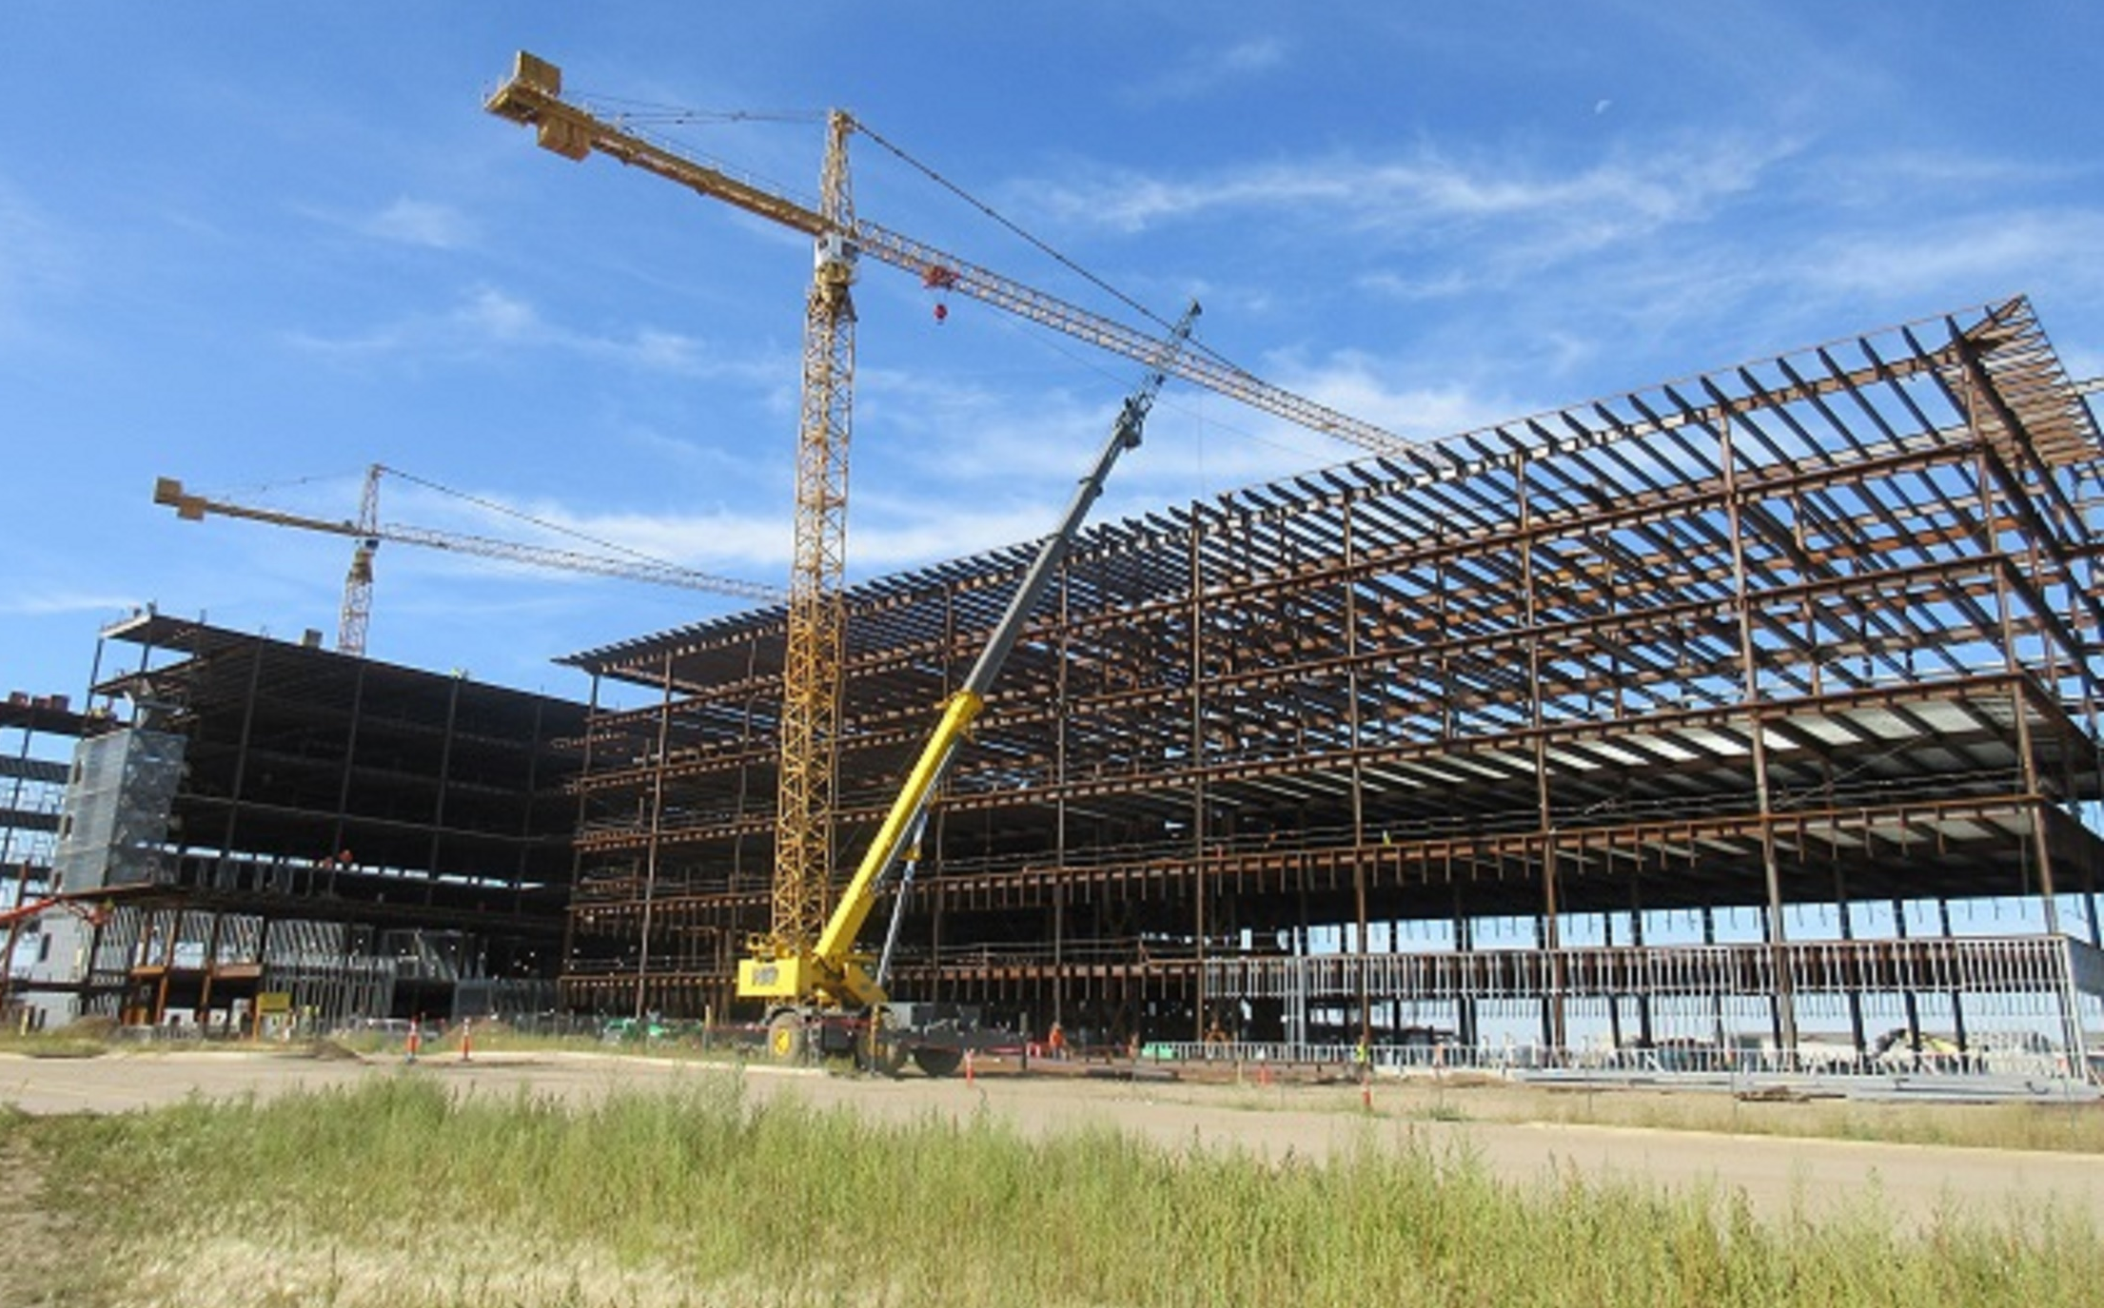
Trinity Hospital Minot, ND
6,000 Tons

Slide 19
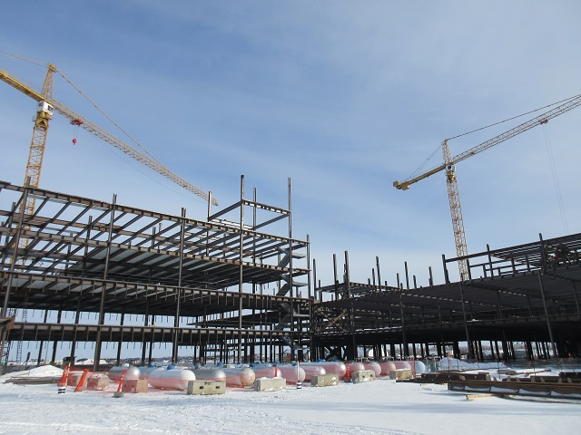
Trinity Hospital Minot, ND
6,000 Tons

Slide 20
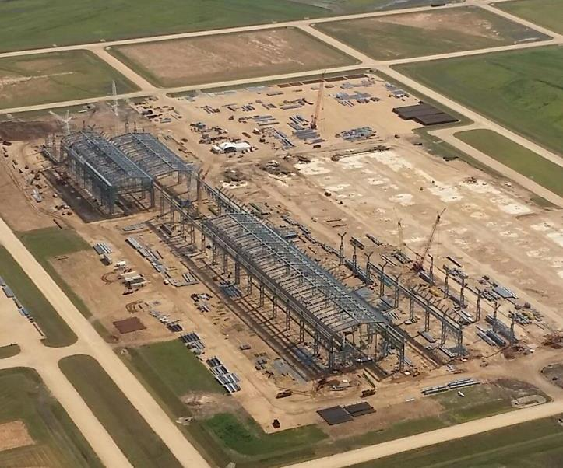
Tenaris Pipe Mill, Bay City, TX
1,800,000 SF 26,000T

Slide 21
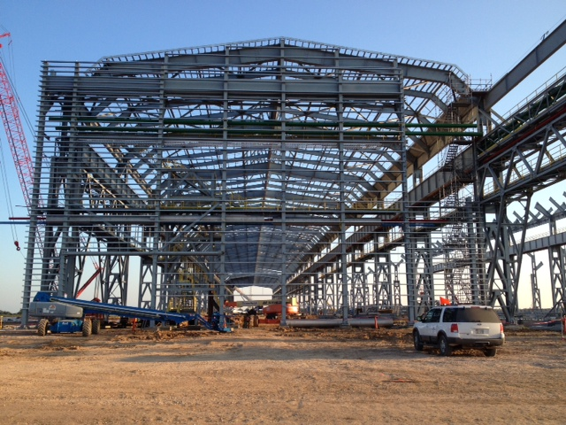
Tenaris Pipe Mill, Bay City, TX
1,800,000 SF 26,000T

Slide 22
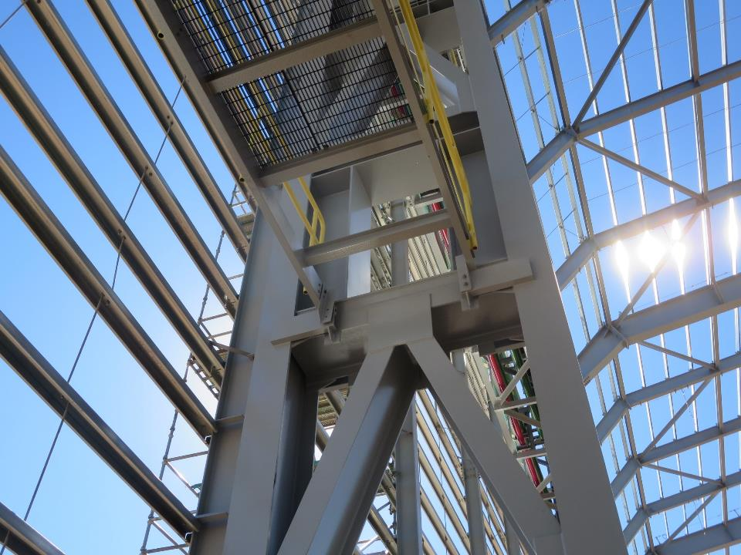
Tenaris Pipe Mill, Bay City, TX
1,800,000 SF 26,000T

Slide 23
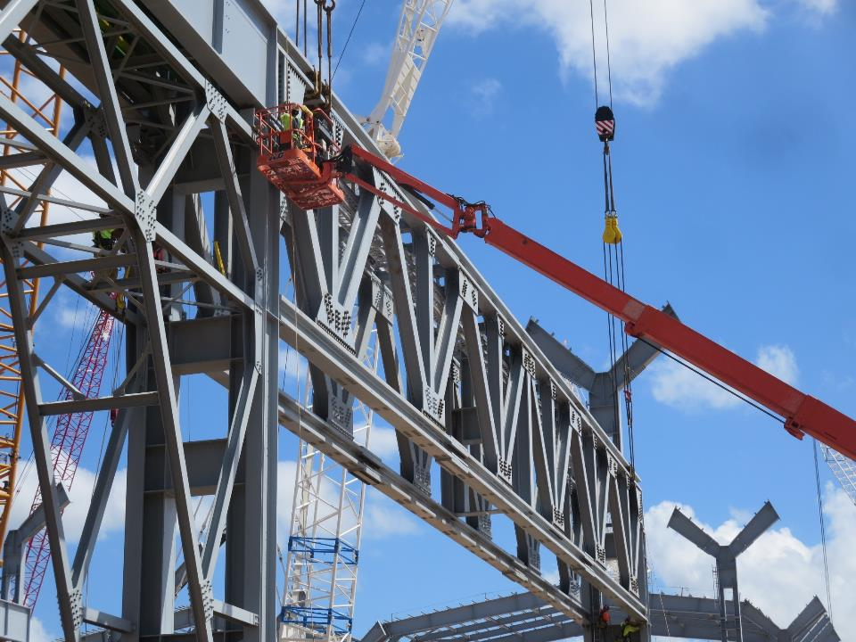
Tenaris Pipe Mill, Bay City, TX
1,800,000 SF 26,000T

Slide 24
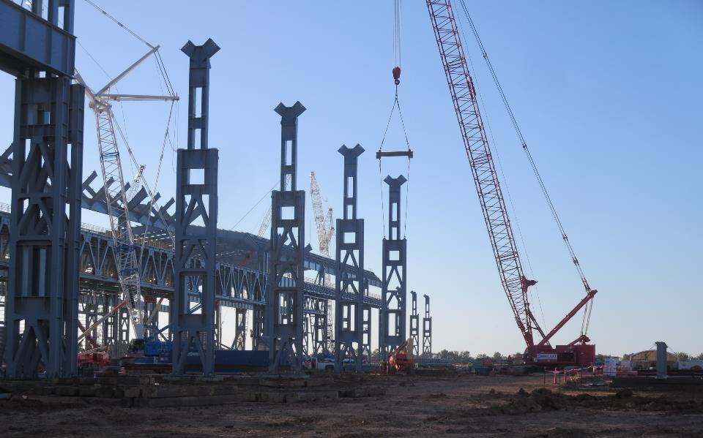
Tenaris Pipe Mill, Bay City, TX
1,800,000 SF 26,000T

Slide 25
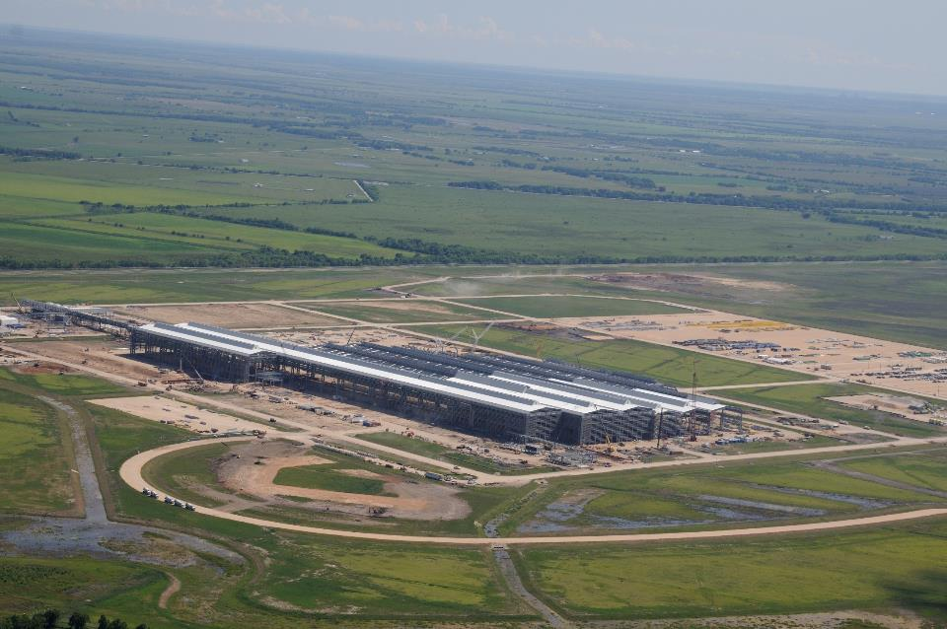
Tenaris Pipe Mill, Bay City, TX
1,800,000 SF 26,000T

Slide 26
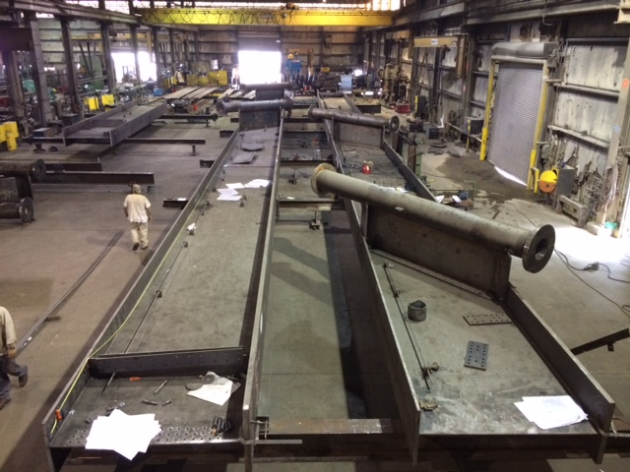
Ohio River Bridge
Downtown Louisville, KY 6,400T

Slide 27
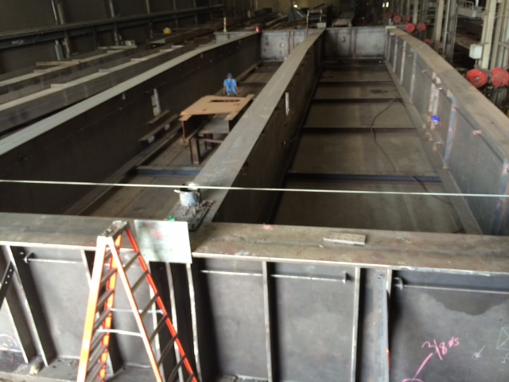
Ohio River Bridge
Downtown Louisville, KY 6,400T

Slide 28
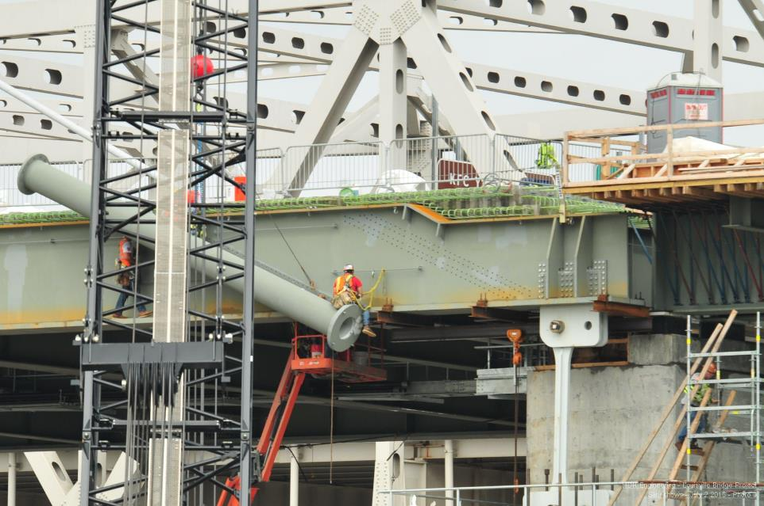
Ohio River Bridge
Downtown Louisville, KY 6,400T

Slide 29
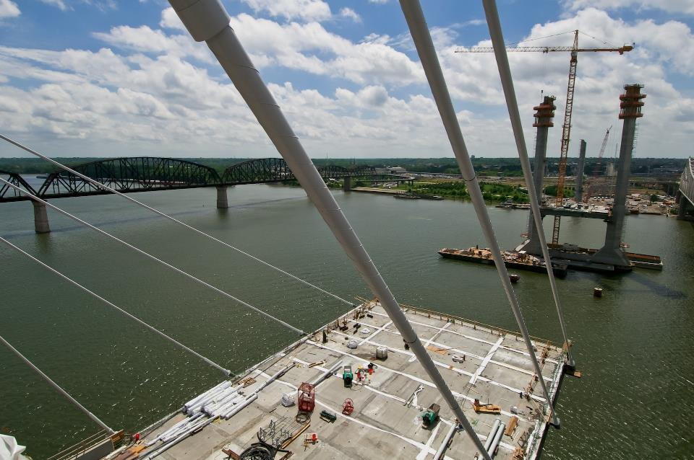
Ohio River Bridge
Downtown Louisville, KY 6,400T

Slide 30
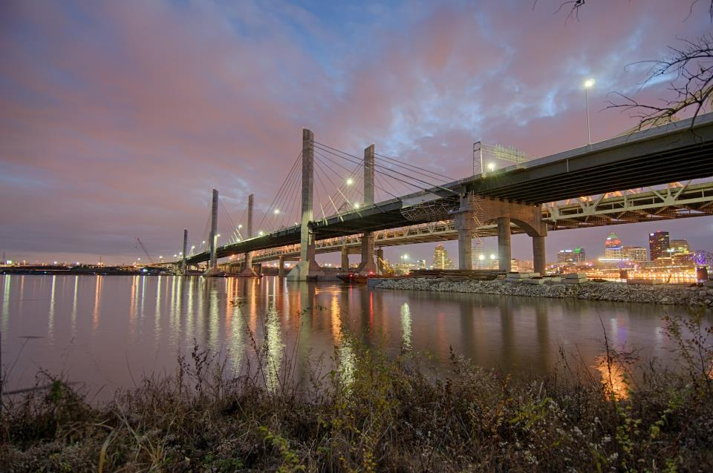
Ohio River Bridge
Downtown Louisville, KY 6,400T

Slide 31
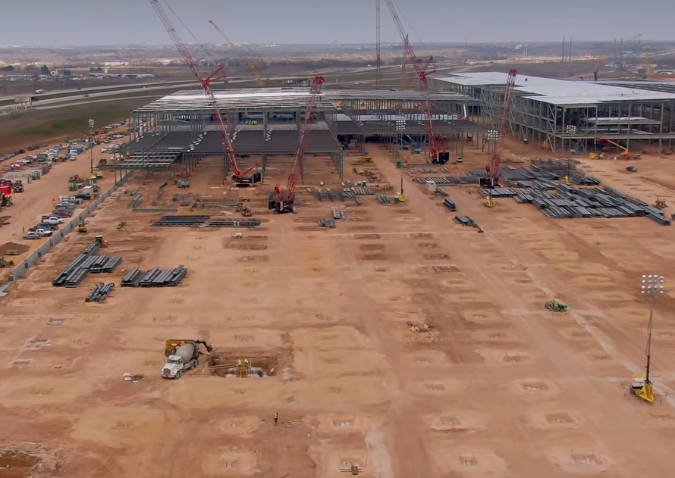
1/30/21
electric vehicle general assembly plant, Austin, TX
1,600,000 SF 36,000 Tons

Slide 32
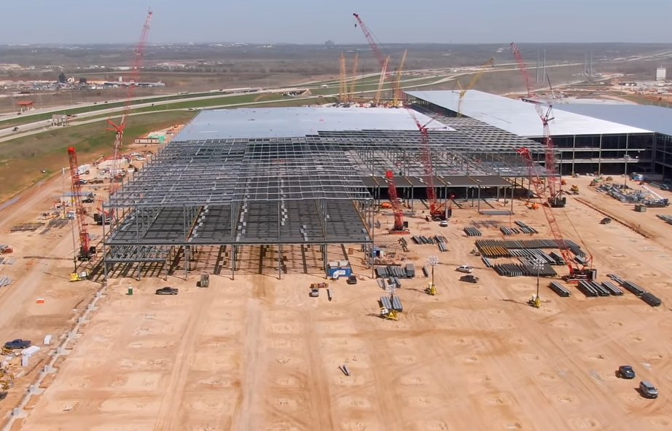
3/15/21
electric vehicle general assembly plant, Austin, TX
1,600,000 SF 36,000 Tons

Slide 33
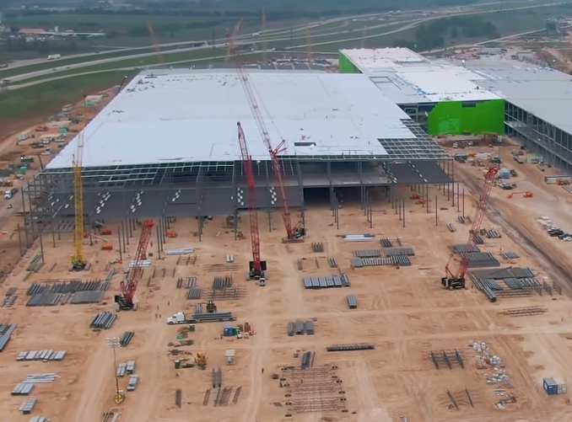
4/15/21
electric vehicle general assembly plant, Austin, TX
1,600,000 SF 36,000 Tons

Slide 34
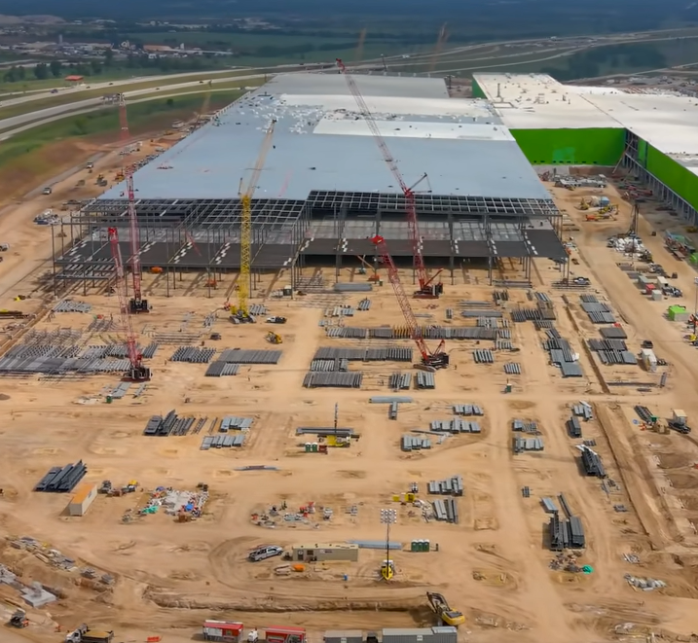
5/15/21
electric vehicle general assembly plant, Austin, TX
1,600,000 SF 36,000 Tons

Slide 35
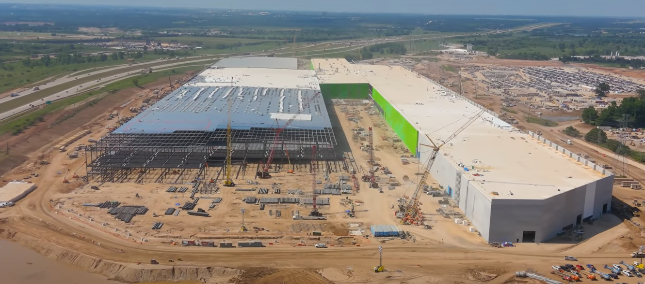
6/17/21
electric vehicle general assembly plant, Austin, TX
1,600,000 SF 36,000 Tons

Slide 36
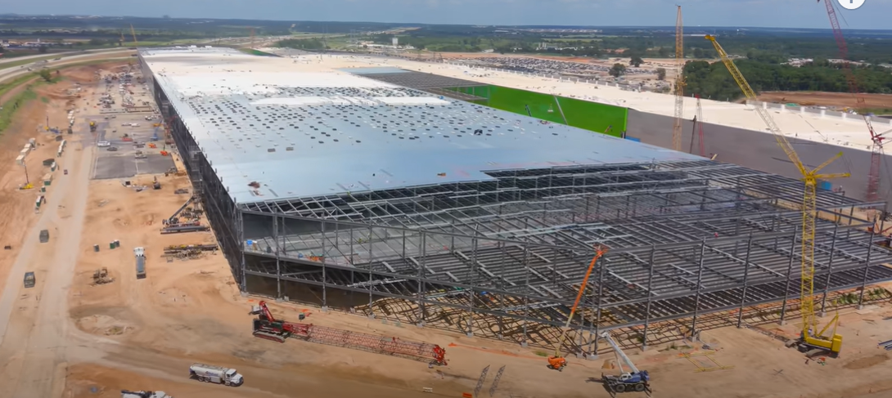
July 2021
electric vehicle general assembly plant, Austin, TX
1,600,000 SF 36,000 Tons

Slide 37
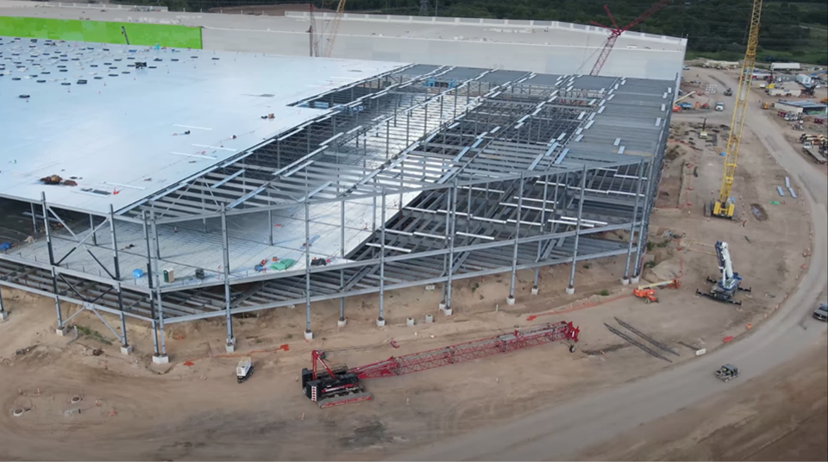
electric vehicle general assembly plant, Austin, TX
1,600,000 SF 36,000 Tons

Slide 38
Thank you!

