Slide 1
General Capabilities

Slide 2
Founded in 1968
Construction contractor with offices in Little Rock, Arkansas, and Houston, Texas
Self performs construction projects with a total installed cost value of up to $200 million
Able to provide EPC Services (Subcontract the Engineering)
Experience in steel, cement, refining, midstream, petrochemical, power and terminals/storage sectors
Yard located in Houston capable of assembling pipe rack modules and skids

Slide 3
Safety Statistics
Year | Labor Hours | Total OSHA Recordable Cases | Total Recordable Incident Rate (TRIR) | Restricted Duty Cases | Restricted Duty Case Rate | Lost Time Cases | Lost Time Incident Rate | Average # of Employees | EMR Rate
2023 | 344354 | 0 | 0.00 | 0 | 0.00 | 0 | 0.00 | 117 | 0.52
2022 | 267340 | 0 | 0.00 | 0 | 0.00 | 0 | 0.00 | 136 | 0.52
2021 | 498,423 | 0 | 0.00 | 0 | 0.00 | 0 | 0.00 | 171 | 0.57
2020 | 955,171 | 3 | 0.63 | 0 | 0.00 | 0 | 0.00 | 397 | 0.68
2019 | 1,262,584 | 3 | 0.48 | 0 | 0.00 | 1 | 0.16 | 479 | 0.59
Through December 2023

Slide 5
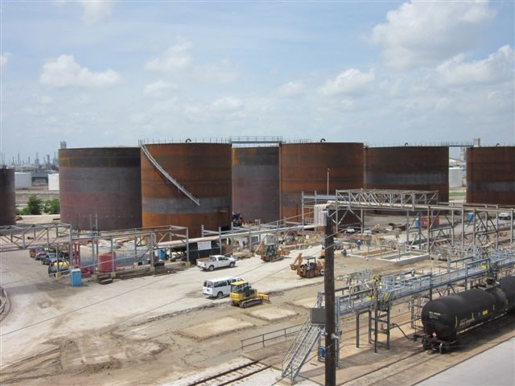
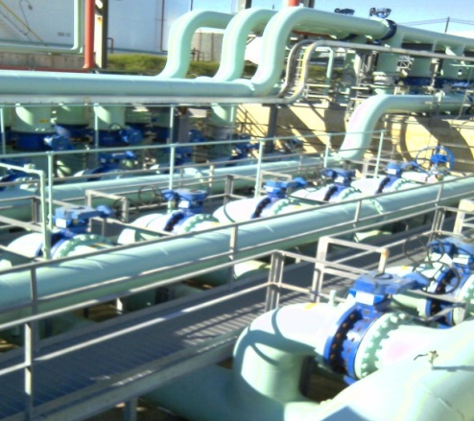
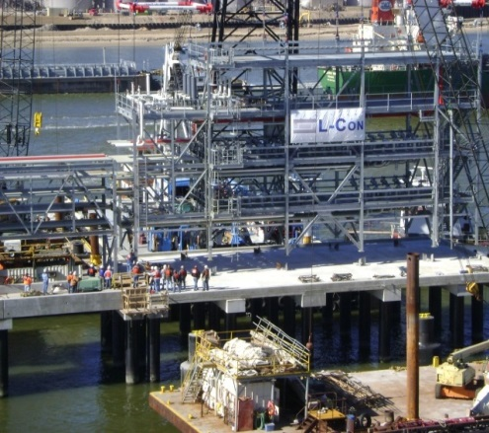
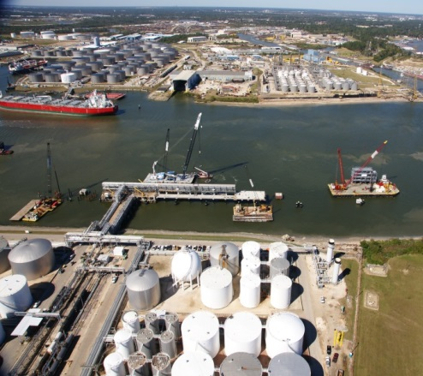
Terminal Industries Served
Bulk Liquids/Chemical/Hydrocarbons
Rail Loading Facilities
Truck Loading Facilities
Blending Terminals
Marine Ship and Barge Loading and Unloading Facilities
Pumping Stations
Pipeline Compressor Stations

Slide 6
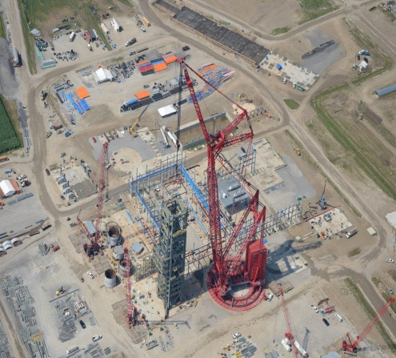
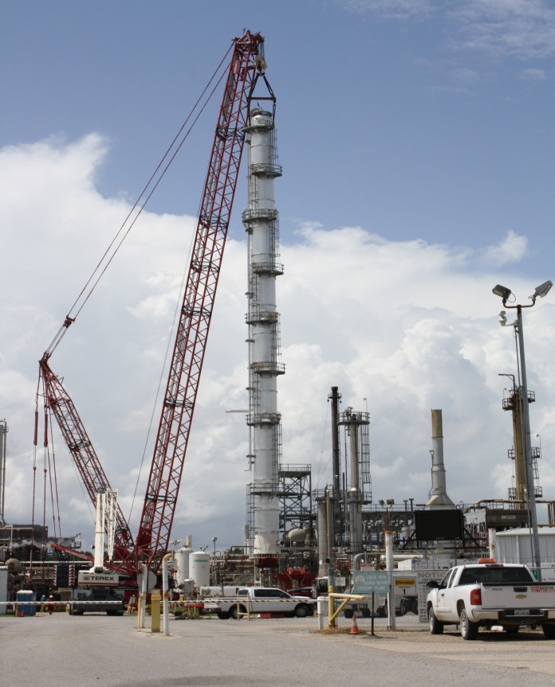
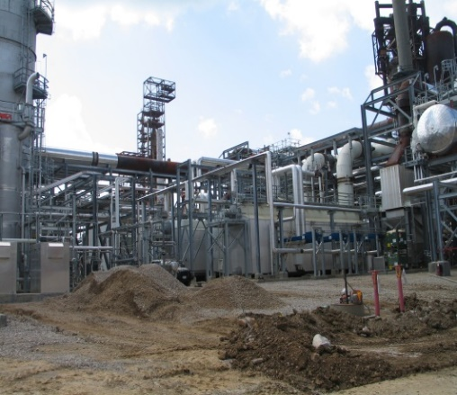
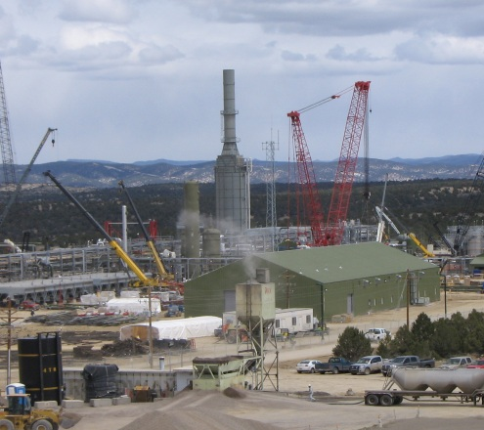
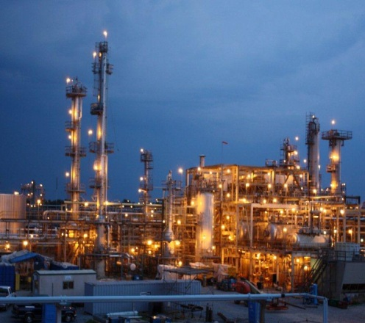
Process Industries Served
Refining
Petrochemical
Chemical
Midstream
Blending/Packaging Facilities
Plant Relocations

Slide 7
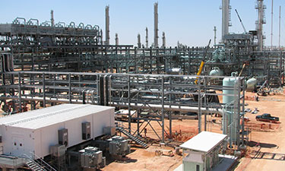
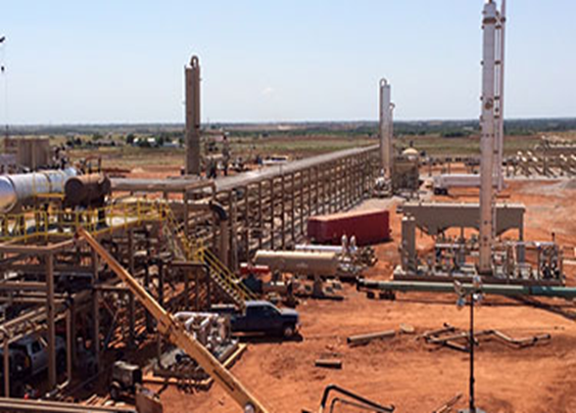
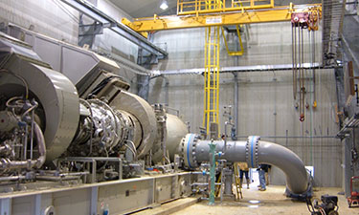
Gas Processing Industry Construction Services
Complete Processing Units
Cryo Plants
Manifolds
Splitters
Compression Stations
Pumping Stations
Rotating Equipment Installation

Slide 8
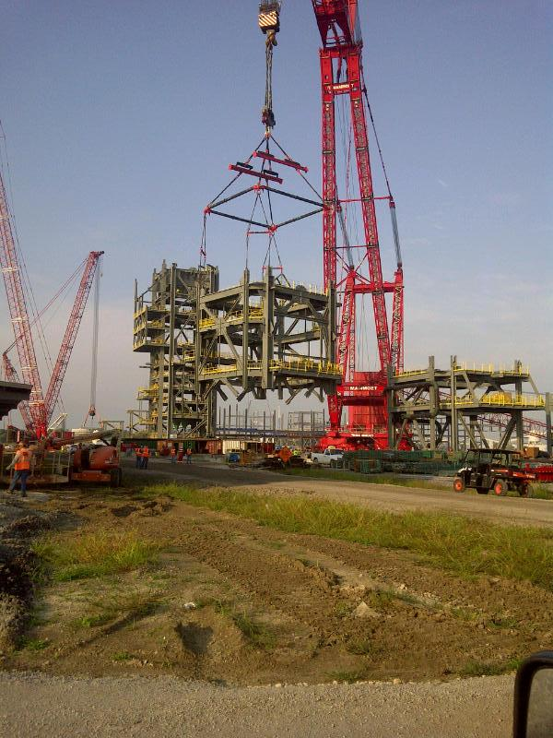
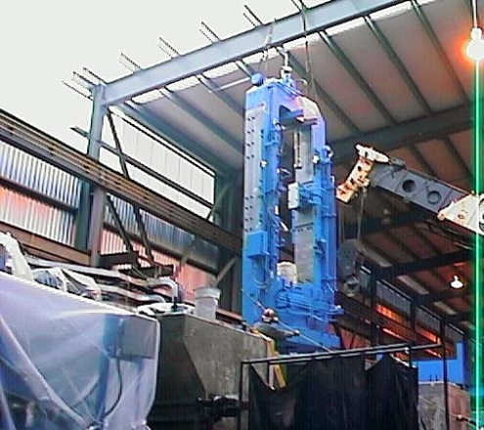
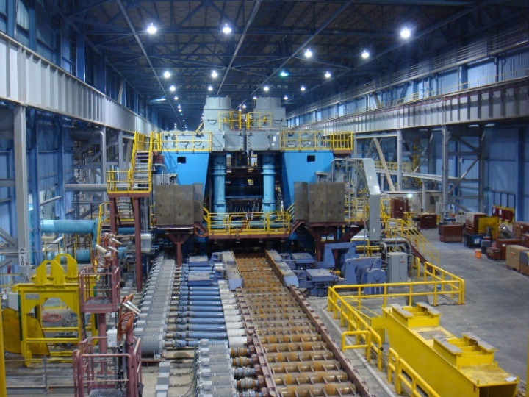
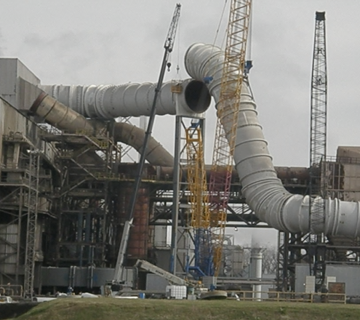
Power, Steel and Heavy Machinery Industries Served
Steel Mill and Steel Manufacturing
Air Quality Control Equipment
Gas Turbine: Single Cycle & Combined Cycle
Steam Turbine Generation

Slide 9
Construction Services
Self Performed by Lexicon
Civil
Foundations
Structural
Piping
Mechanical
Coatings
Insulation
Scaffolding
Subcontracted and managed by Lexicon
Engineering
Electrical
I&C
Rigging (Heavy Lifts)

Slide 10
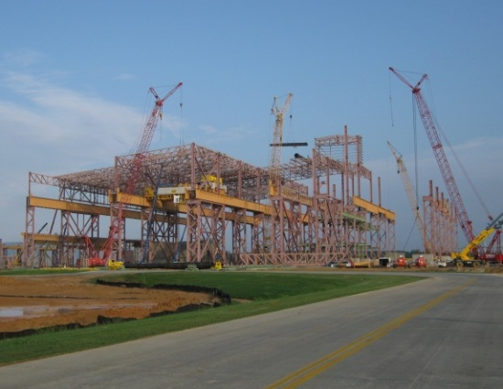
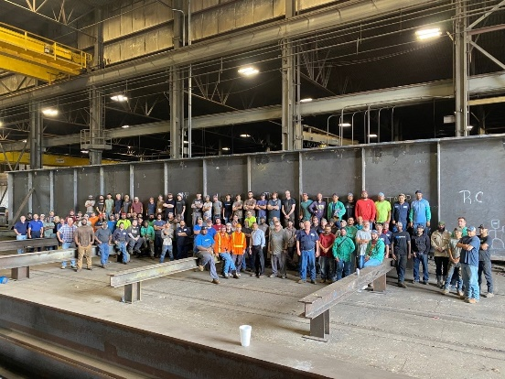
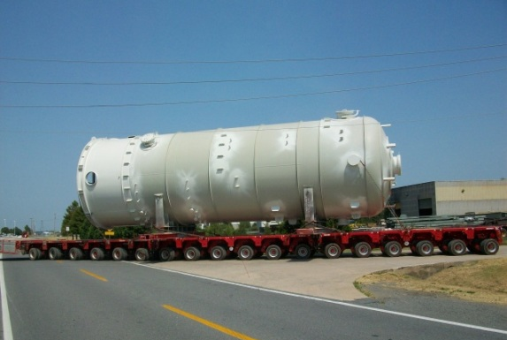
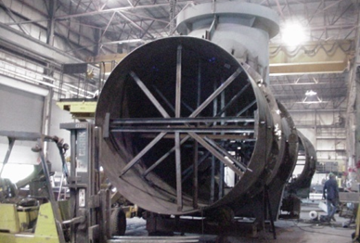
Fabrication Capabilities In-house structural, plate work and pressure vessel fabrication
Custom Metals
Platework & Pressure Vessel Fabrication
700,000 ft² Indoor Shop Space
120,000 tons/year production capacity
AISC Certified
Building Fabricator
Certified Bridge Fabricator
Fracture-Critical Endorsement
Sophisticated Paint Endorsements
170,000 ft² Indoor Shop Space
ASME U, R, S & PP Stamps
Plate Burning Capabilities 16’ x 60 ’ x 7” thick
Plate Rolling to 2 ½” x 10’
Crane Capacity of 80 tons

Slide 11
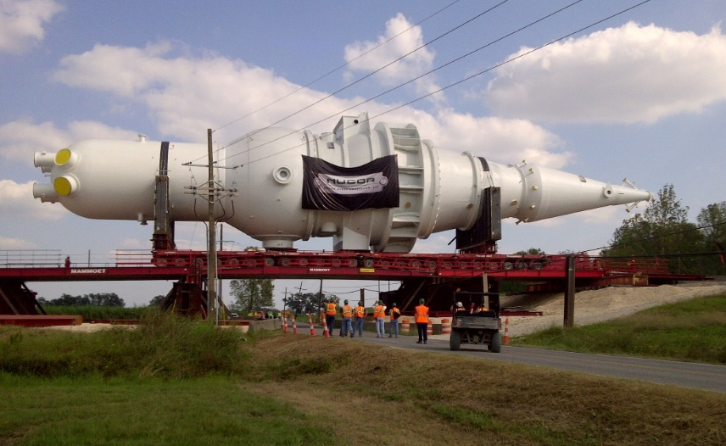
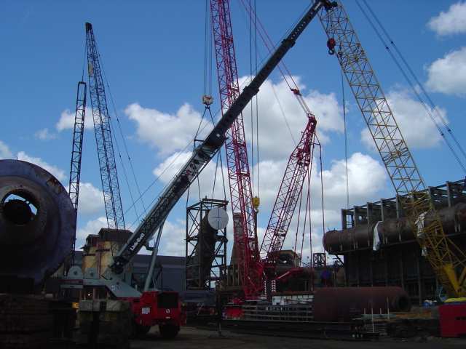
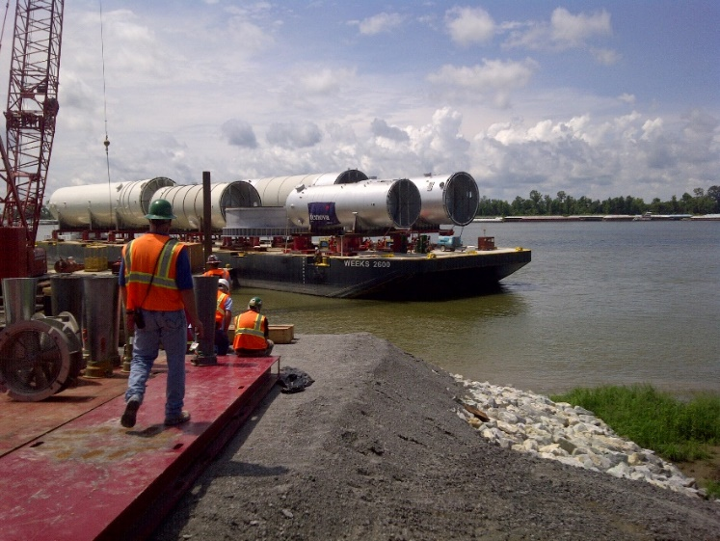
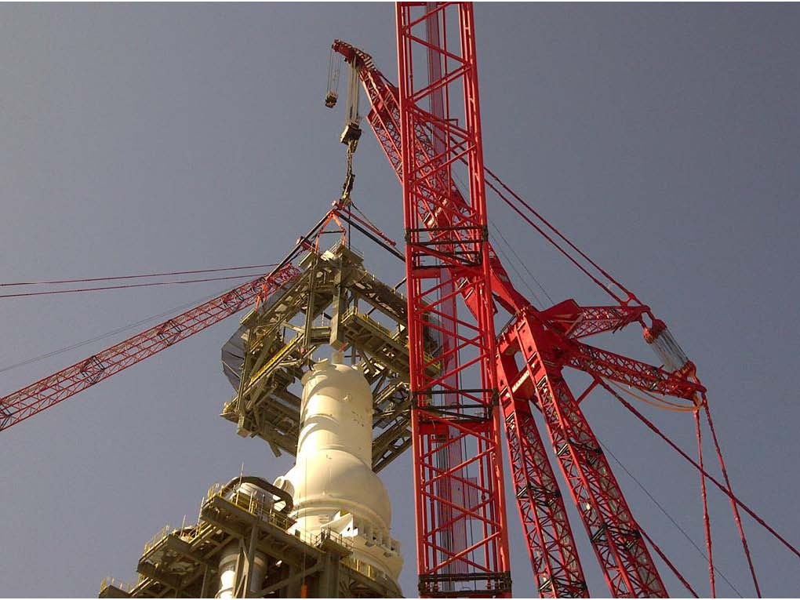
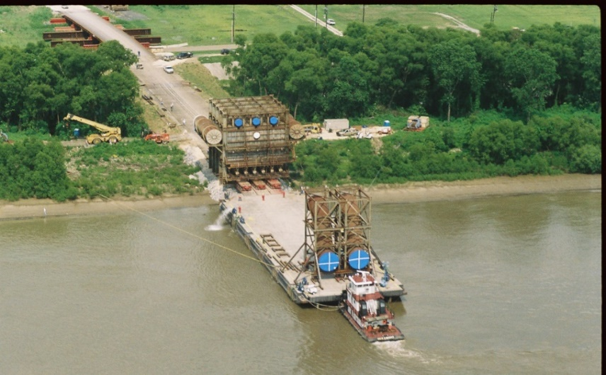
Heavy Industrial Facility Relocations and Installations

Slide 12
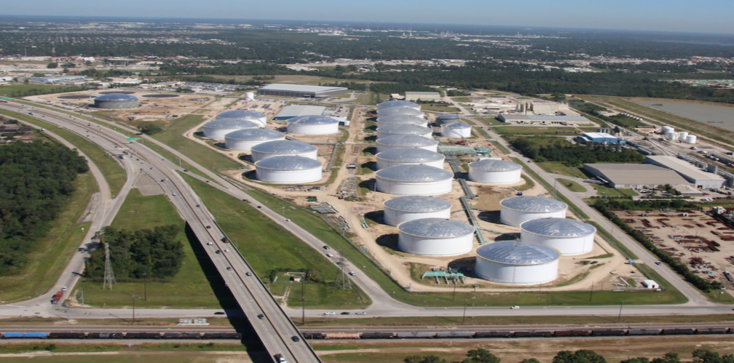
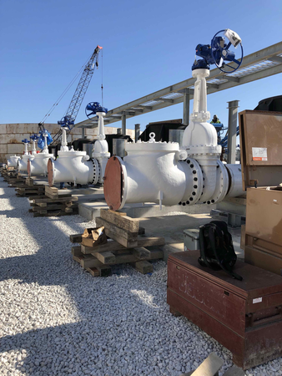
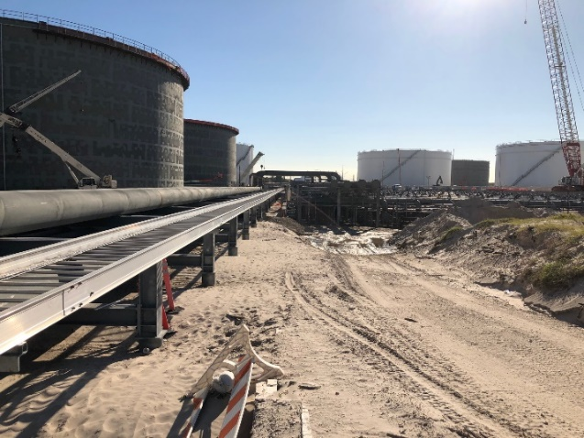
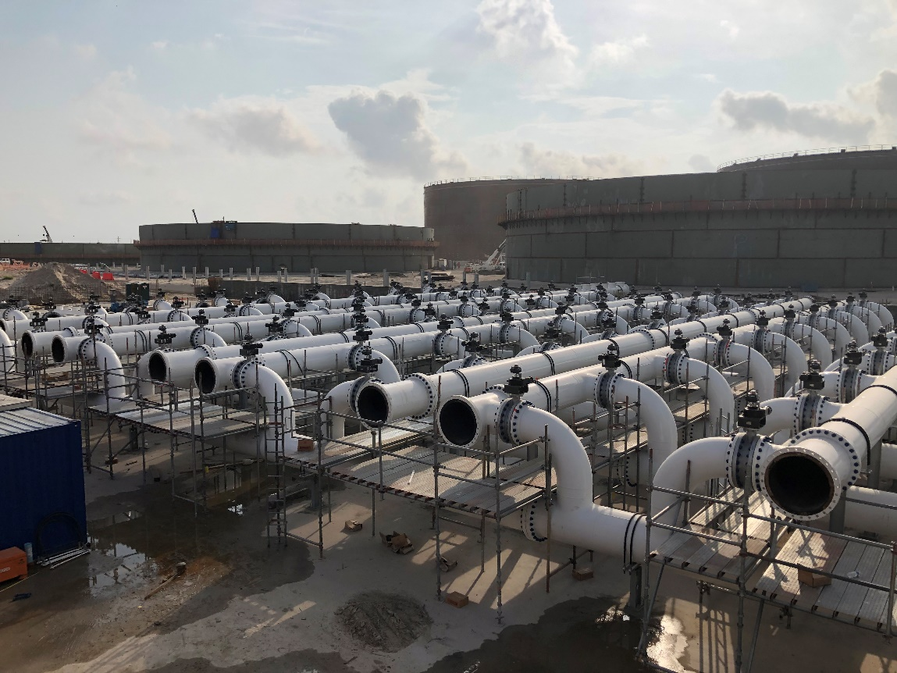
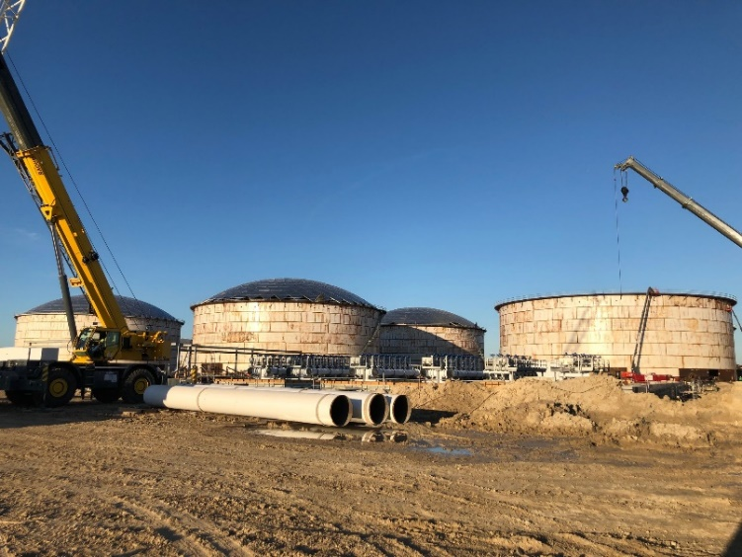
Construction of Major Terminals and Expansion

Slide 13
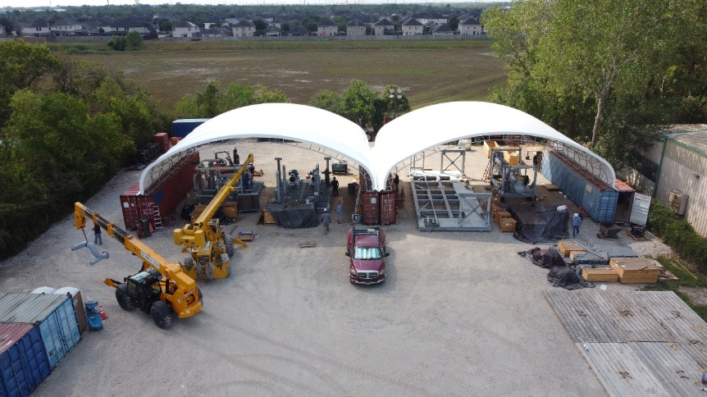
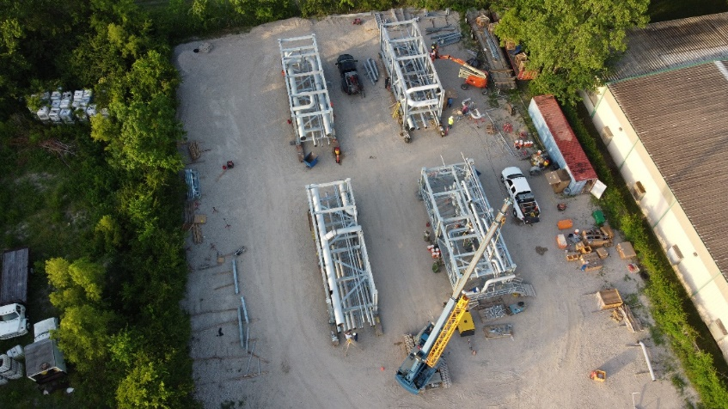
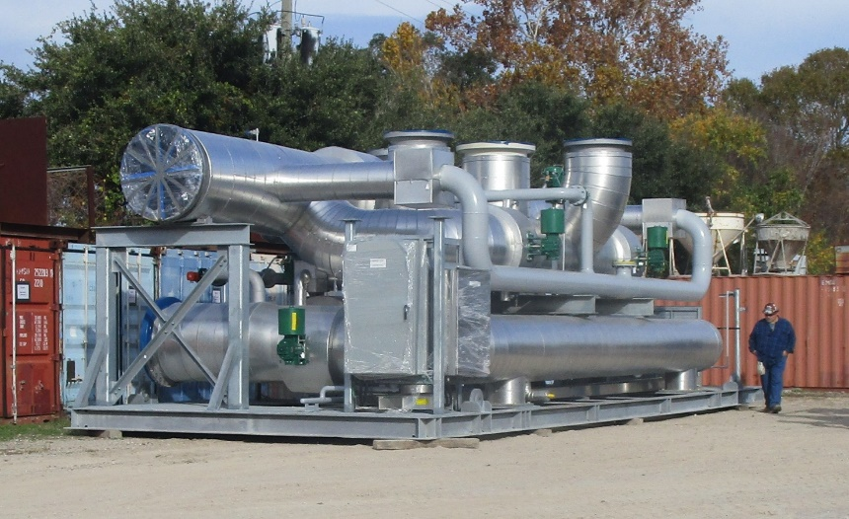
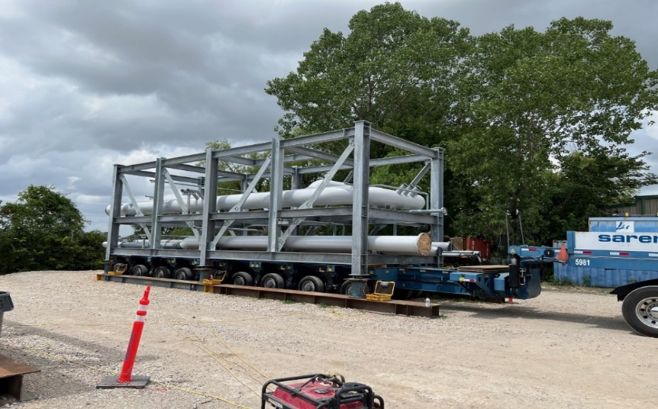
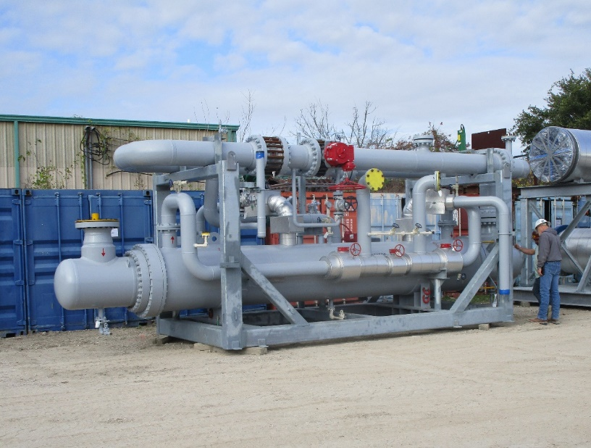
Module and Skid Assembly

Slide 14
Thank You We welcome the opportunity to serve you.
Lexicon, Inc.
Corporate Office
8900 Fourche Dam Pike
Little Rock, Arkansas 72206
(800) 925-4565
Houston Office
12301 Kurland Drive
Suite 200
Houston, Texas, 77034
(281) 484-5266
www.lexicon-inc.com

