Slide 1
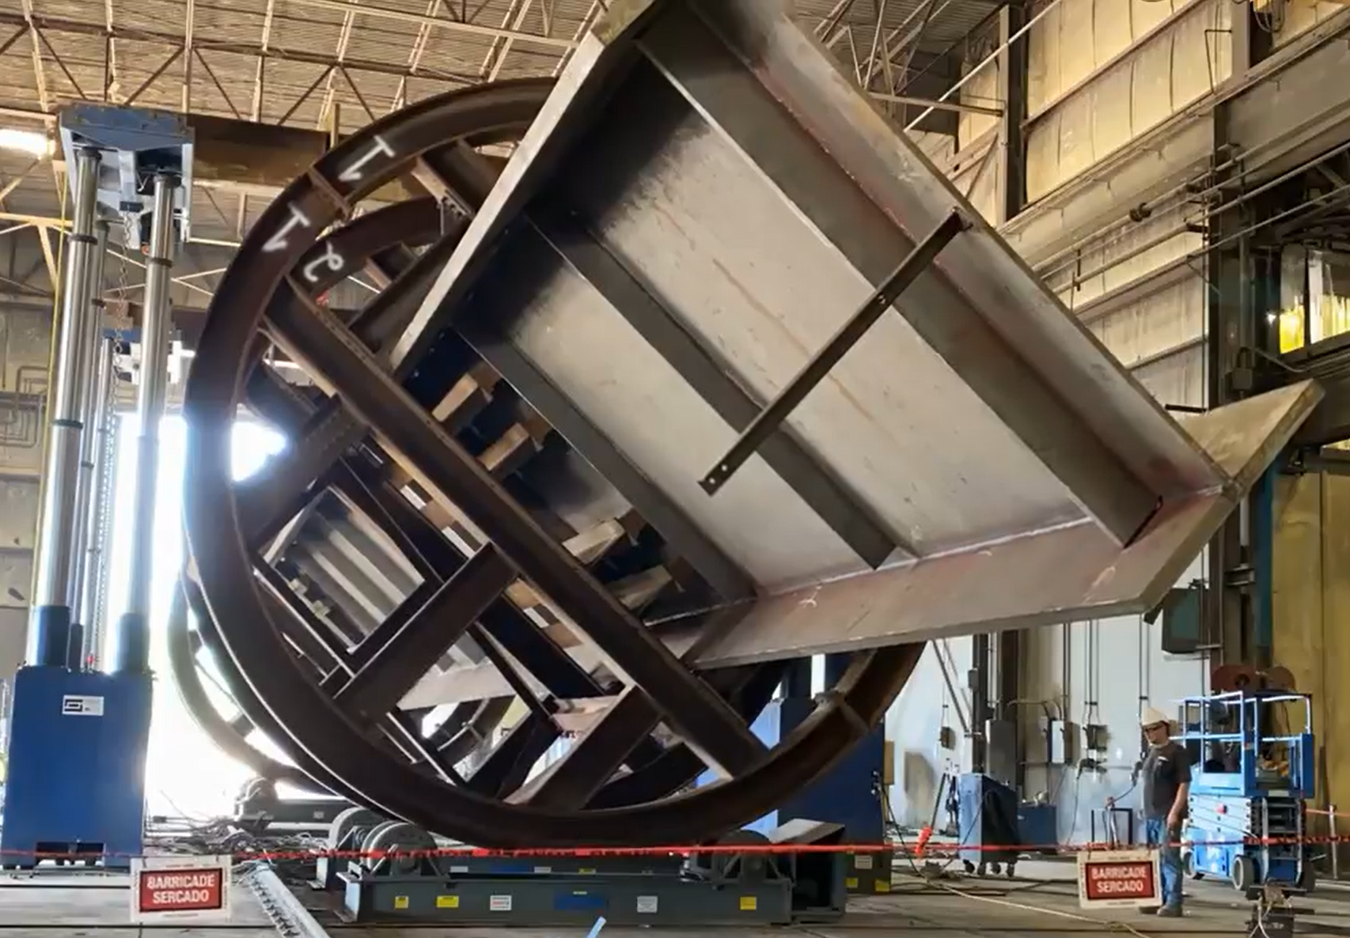
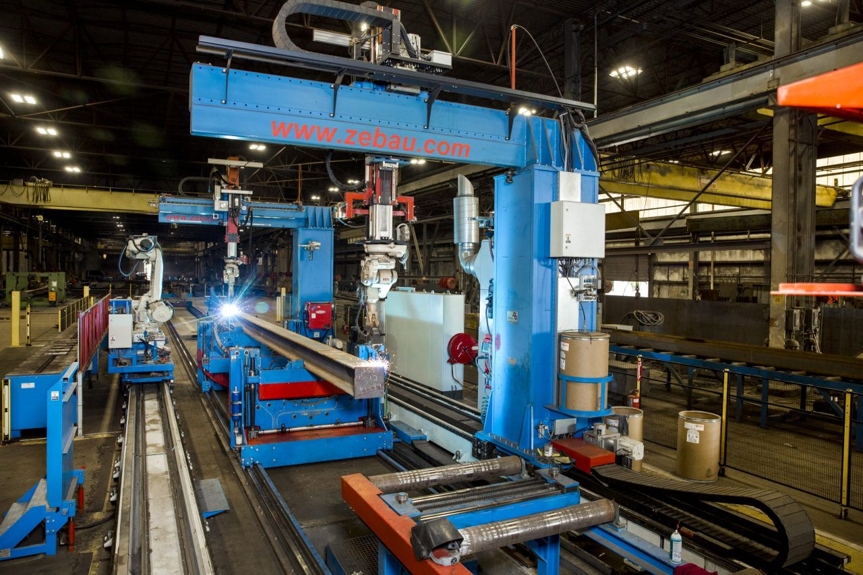
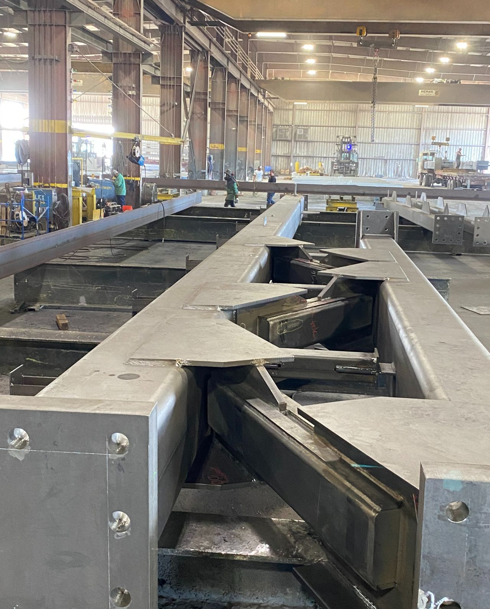

Slide 2
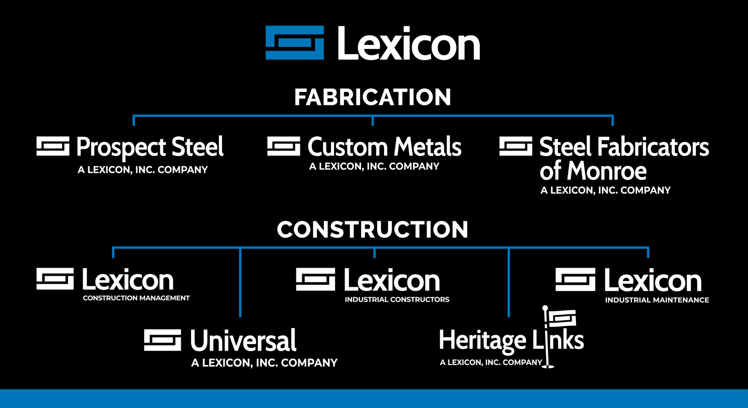



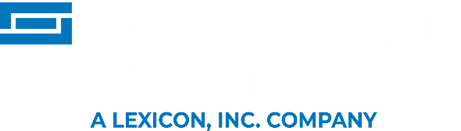





FABRICATION GROUP
CONSTRUCTION GROUP

Slide 3
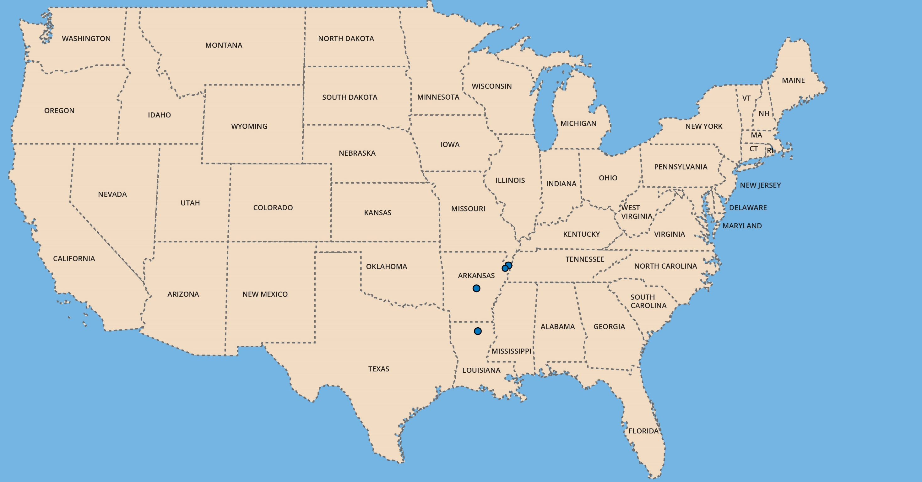

Prospect Steel Plant Network
Blytheville Plants (2)
Minimal inbound freight cost for shipping fabricated steel throughout the U.S.
Major projects fabricated and erected nationally. (Examples to follow.)
Full-time Prospect Steel Site Manager on each project.
Local fab sourcing for any on-the-fly steel required.
Little Rock HQ and plants (2)
Nucor Yamato Steel
Monroe Plant (1)

Slide 4


Project Big Bird Tracy, CA
3,800,000 SF 26,000 Tons
Lexicon Fabrication Plants
Little Rock, AR Prospect Steel 250,000 SF
Custom Metals 168,000 SF
Blytheville, AR Prospect Steel 150,000 SF
Lex Fab 36,000 SF
Monroe, LA SFM 150,000 SF
754,000 SF
AISC Certifications
Certified Building Fabricator
Certified Bridge Fabricator
Fracture-Critical Endorsement
Sophisticated Paint Endorsements
Lexicon, Inc.
Fabrication, erection, industrial contracting
58 yrs. in business – since 1968
.64 EMR 1.53 TRIR
$1.3 billion revenue in 2025. ($600M Fabrication Group.)

Slide 5
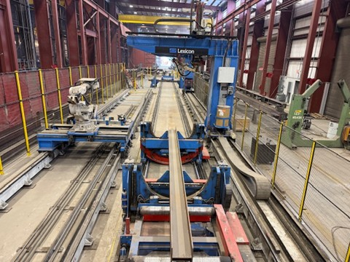
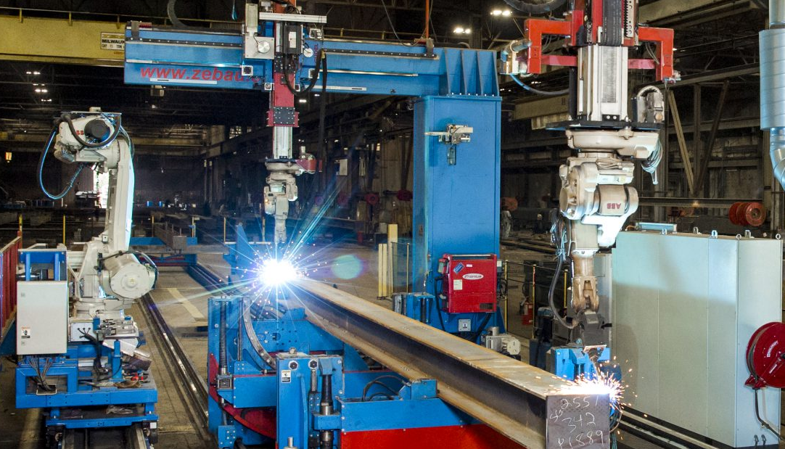
Project Big Bird Tracy, CA
3,800,000 SF 26,000 Tons
120,000 tons/year production capacity, self-perform.
Additional 60,000 tons/year capacity through our Subfab Dept.
Bonding: $350M single project, $500M aggregate
Nucor/Vulcraft relationship
Nucor’s largest fabricator customer
Proximity to the mill – next door and 3 hrs. away
Lexicon’s ongoing work inside Nucor’s mills
Leader in robotic fabrication
5 robotic fit-and-weld beam lines
Up to 85% production time-savings

Slide 6
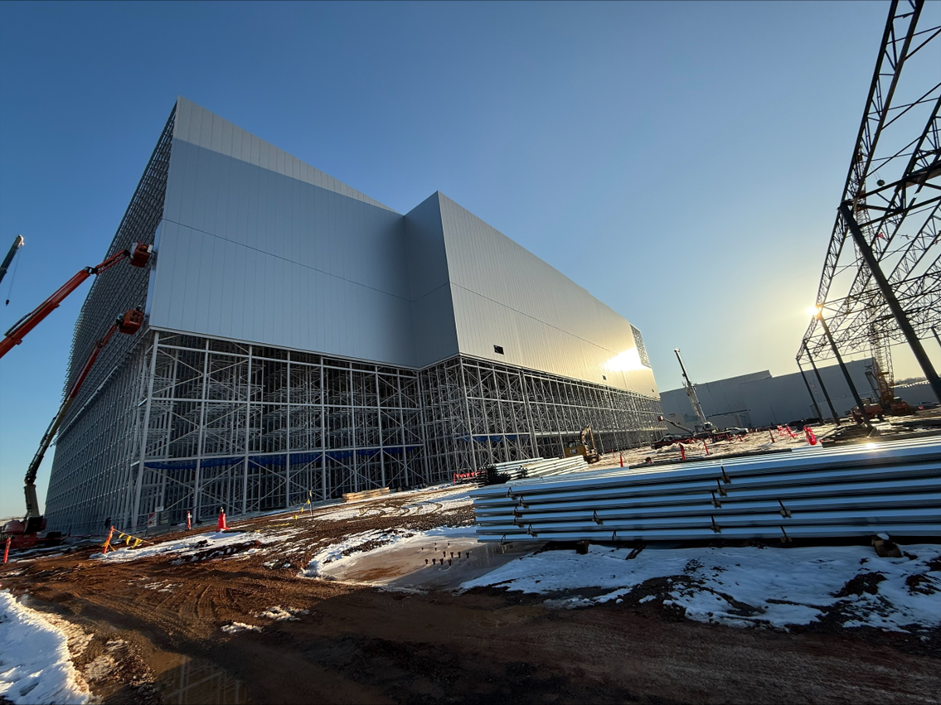
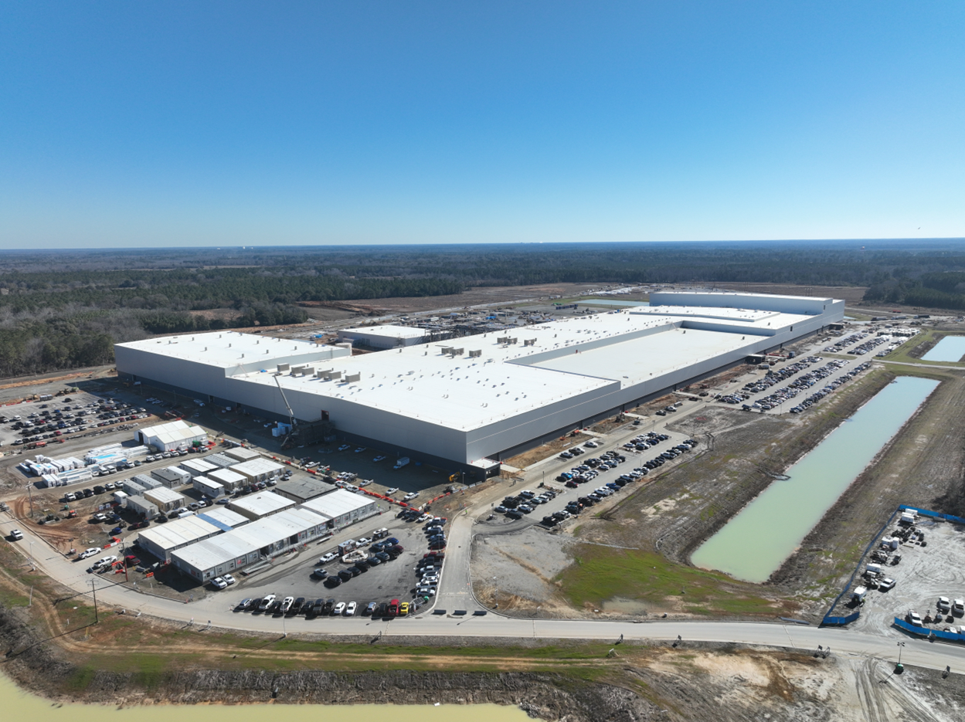
Project Big Bird Tracy, CA
3,800,000 SF 26,000 Tons
Universal – division of Lexicon, Inc.
SUPPLIES & INSTALLS:
Metal Cladding (IMP, ACM, Single Skin + Building Insulation)
Process pipe & tank insulation and lagging + Heat Tracing
Pipe and tank coatings
Scaffolding
CLEAN ROOM PARTNERSHIP
Universal supplies/installs the interior IMP walls & ceilings
Precision Environments designs, builds and certifies entire installation, incl. MEP.
Precision-Lexicon joint venture.

Slide 7
Project Big Bird Tracy, CA
3,800,000 SF 26,000 Tons
 |  | Awarded | Project | Location | Type |  | Tons |  | Million SF
1 |  | 2017 | Project Rio (DEN3) | Denver, CO | 855 |  | 12,044 |  | 2.4
2 |  | 2017 | Project Goliath (CLE2) | Cleveland, OH | 855 |  | 13,096 |  | 2.4
3 |  | 2018 | Project Bark (CLE3) | Cleveland, OH | 855 |  | 12,994 |  | 2.4
4 |  | 2018 | Project Wildcat (TUC) | Tucson, AZ | 855 |  | 11,327 |  | 2.4
5 |  | 2018 | Project Cherry | Beaumont, CA | 640 |  | 20,581 |  | 2.8
6 |  | 2018 | Project Bronco | Boise, ID | 640 |  | 20,072 |  | 2.8
7 |  | 2018 | Project Freddie | Toledo, OH | 640 |  | 19,482 |  | 2.8
8 |  | 2019 | Project Lonestar | Salt Lake City, UT | TNS |  | 6,162 |  | 1.4
9 |  | 2019 | Project Bluejay | Des Moines, IA | 640 |  | 20,072 |  | 2.8
10 |  | 2019 | Project Arcilla | San Diego, CA | G+4.5M |  | 23,198 |  | 3.4
11 |  | 2019 | Project Rodeo | Colo. Springs, CO | G+4.5L |  | 24,468 |  | 3.8
12 |  | 2019 | Project Diamond | Little Rock, AR | G+4.5L |  | 18,916 |  | 3.8
13 |  | 2020 | Project Diana | Waco, TX | 640 |  | 18,092 |  | 2.8
14 |  | 2020 | Project Big Bird | Tracy, CA | G+4.5L |  | 26,302 |  | 3.8
15 |  | 2020 | Project Armadillo | Amarillo, TX | TNS |  | 6,711 |  | 1.4
16 |  | 2021 | Project Mastodon (FWA6) | Fort Wayne, IN | G+4.5M |  | 20,509 |  | 3.4
17 |  | 2021 | Project Scrabble | Davenport, IA | G+4.5M |  | 22,781 |  | 3.4
18 |  | 2021 | Project Basie (PDX8) | Woodburn, OR | G+4.5L |  | 24,220 |  | 3.8
19 |  | 2021 | Project Sugar (DEN9) | Loveland, CO | G+4.5L |  | 25,200 |  | 3.8
20 |  | 2024 | Project Goat (SJC8) | Salinas, CA | G+4.5M |  | 22,781 |  | 3.4
21 |  | 2024 | Project Silver Eagle (MKE3) | Cottage Grove, WI | G+4.5M |  | 22,781 |  | 3.4
 |  |  |  |  | Total |  | 391,789 |  | 62.4
Amazon Resume
21 Projects
391,789 Tons
62.4 Million SF

Slide 8
Project Big Bird Tracy, CA
3,800,000 SF 26,000 Tons
Data Center Resume
End Customer | Location | Qty. Bldgs. | Tonnage | Status
Serverfarm | Hockley, TX | 1 | 5,000 | Active
AWS | Spotsylvania, VA | 1 | 2,200 | Active
AWS | Marysville, OH | 1 | 1,800 | Active
QTS | Cedar Rapids, IA | 2 | 10,200 | Active
EdgeConneX | New Albany, OH | 2 | 8,500 | Active
SDC | Auburn, VA | 2 | 23,300 | Active
Meta | Holly Ridge, LA | 6 | 14,300 | Active
Switch | Reno, NV | 1 | 11,300 | Complete
AWS | Reno, NV | 1 | 2,300 | Complete
DLR | Hillsboro, OR | 1 | 4,500 | Complete
QTS | Goodyear, AZ | 2 | 12,000 | Complete
Google | New Albany, OH | 2 | 1,100 | Complete
Google | Clarksville, TN | 2 | 5,600 | Complete
 |  | 24 | 102,100
24 data centers
102,100 tons
9 Owners
2018-Present

Slide 9
Project Big Bird Tracy, CA
3,800,000 SF 26,000 Tons
Current Market Focus:
Data Centers
Semi-Conductor Plants
Advanced Manufacturing
Pharmaceutical
Warehouse / Distribution
Convention Centers
Healthcare
Steel Mills

Slide 10
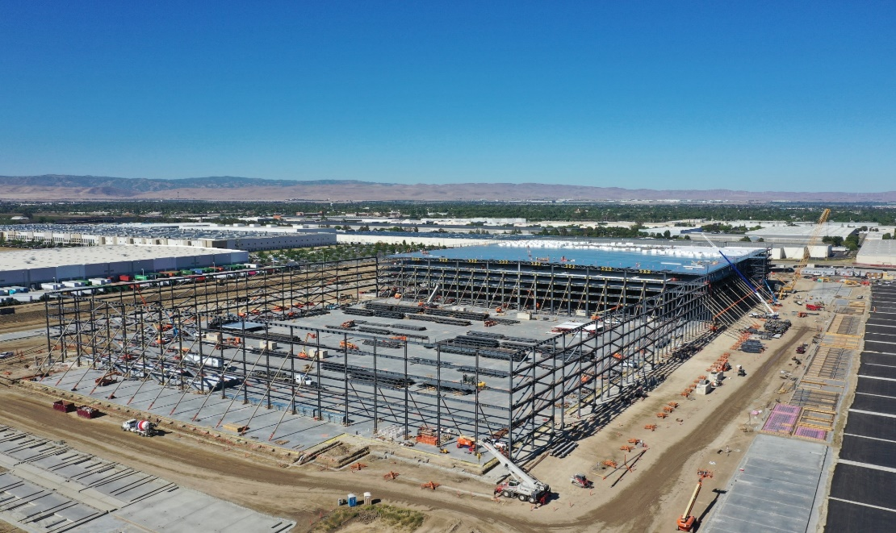
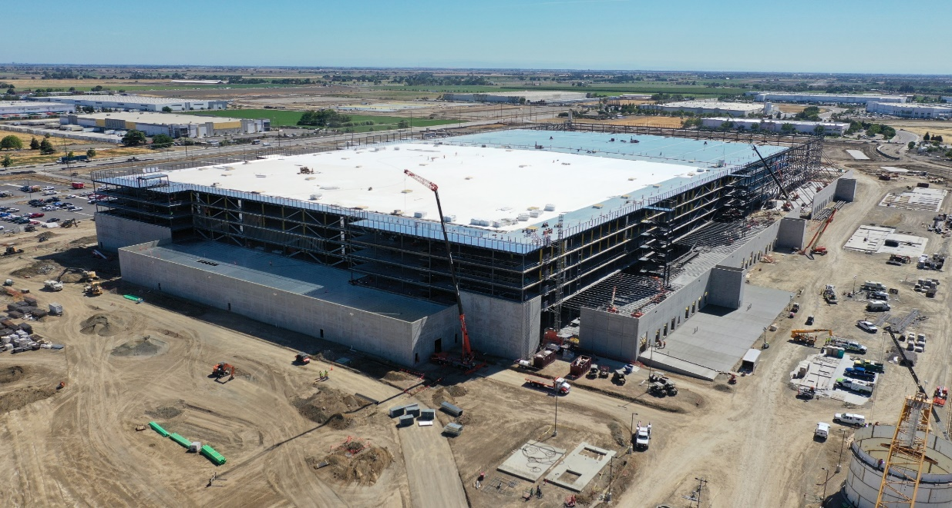
e-Commerce Fulfillment Centers
Project Big Bird – Tracy, CA 26,000 tons 3,800,000 SF

Slide 11
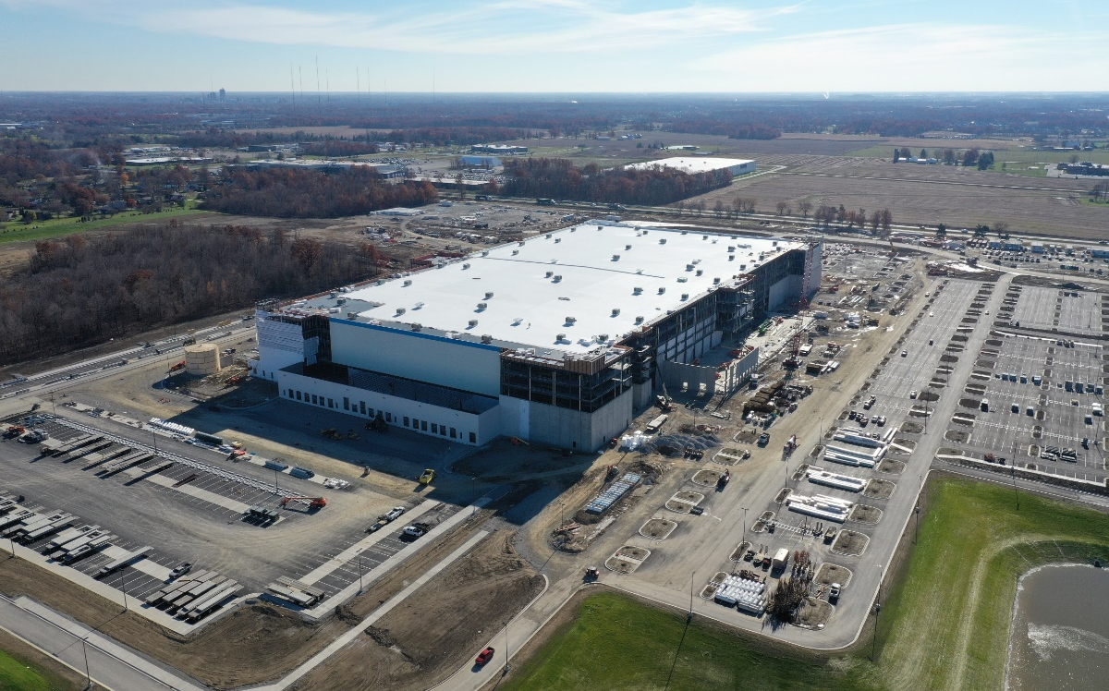
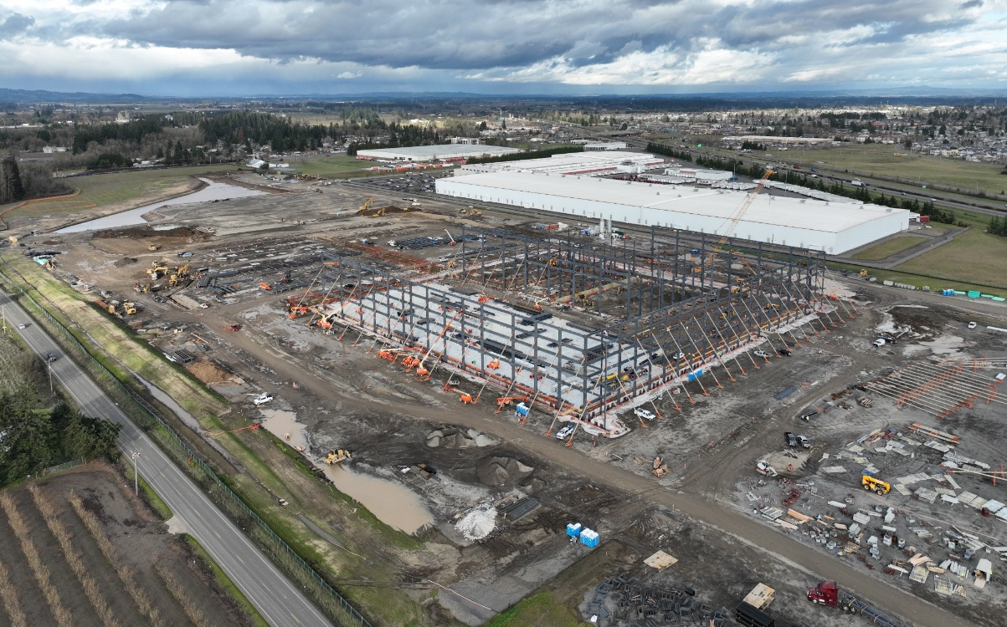
e-Commerce Fulfillment Centers
Project Mastodon
Fort Wayne, IN 20,500 Tons 3,400,000 SF
Project Basie
Woodburn, OR 24,200 Tons 3,800,000 SF

Slide 12
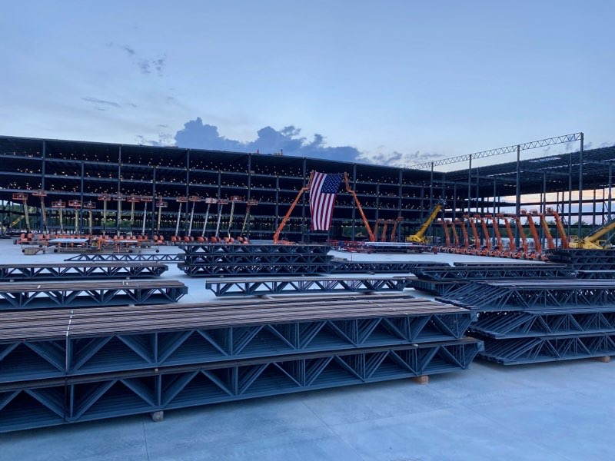
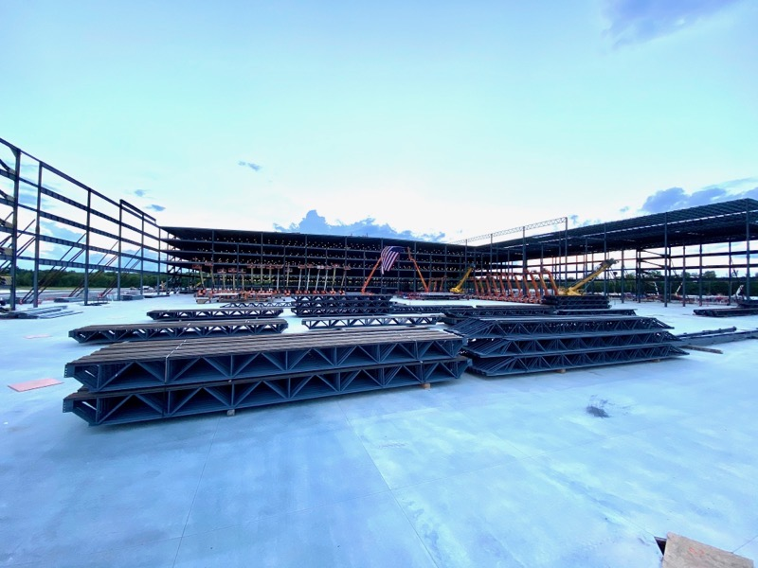
e-Commerce Fulfillment Centers
Project Diamond – Little Rock, AR 19,500 tons 3,800,000 SF

Slide 13
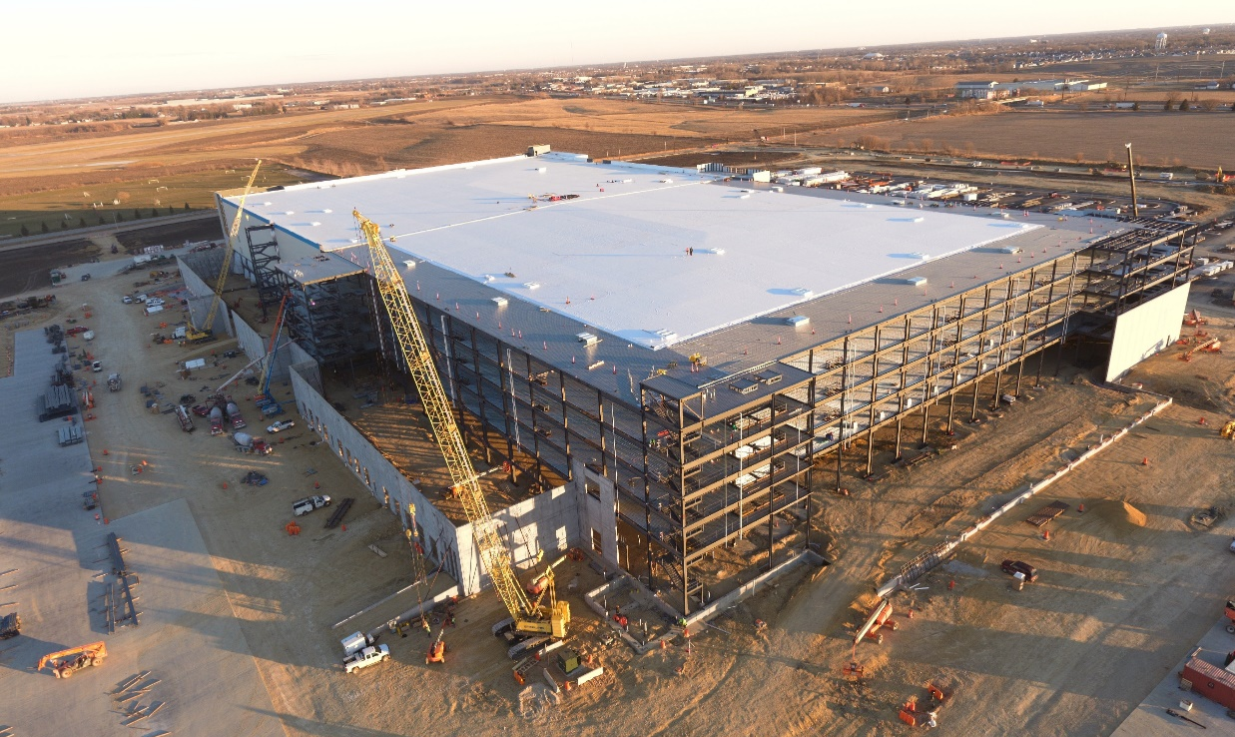
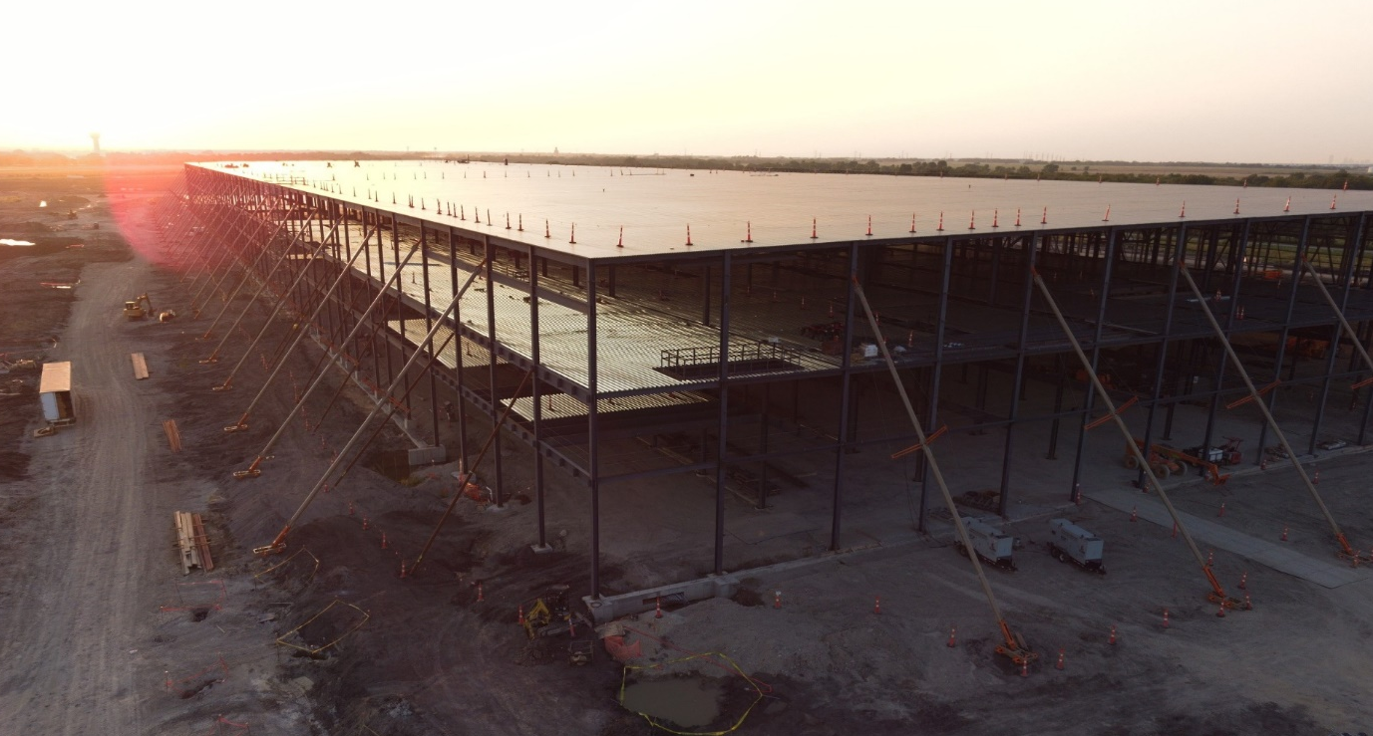
e-Commerce Fulfillment Centers
Project Scrabble
Davenport, IA 22,700 Tons 3,400,000 SF
Walmart Fulfillment Center
Dallas, TX 13,000 Tons 2,500,000 SF

Slide 14
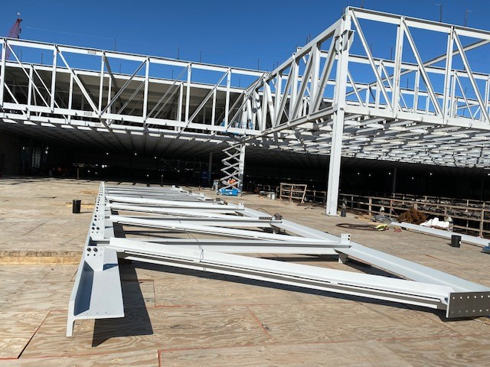
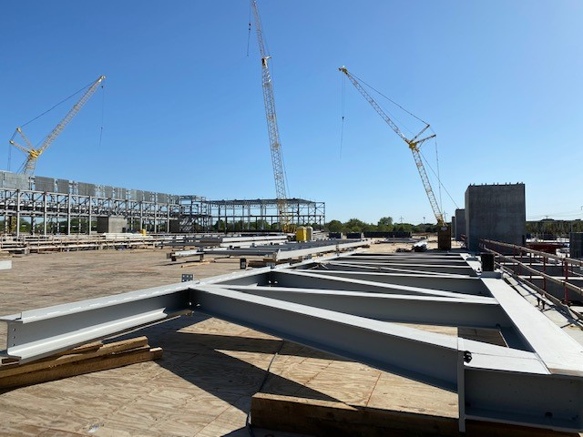
Semi-Conductor Plants
Semi-conductor Plant Expansion – Dallas, TX 11,000 Tons 600,000 SF

Slide 15
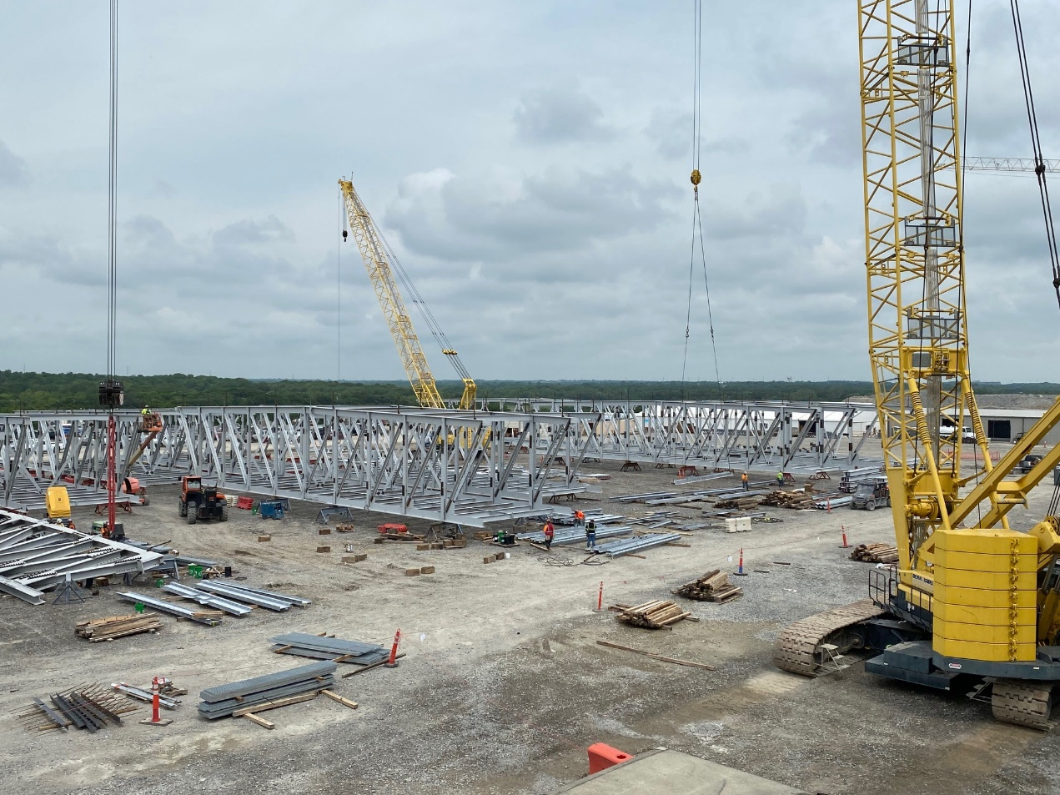
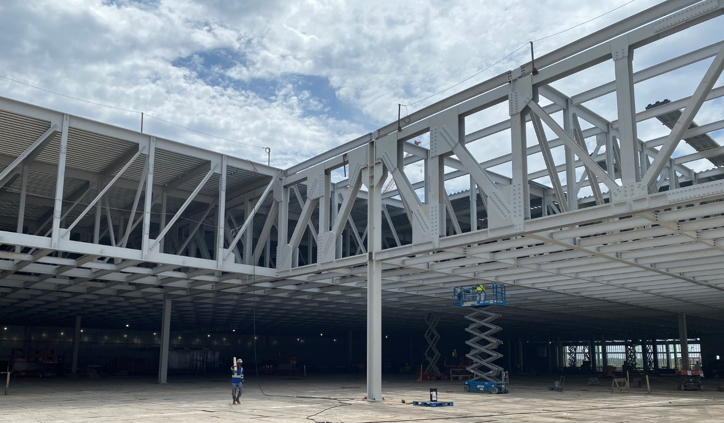
Semi-Conductor Plants
SM1/SM2 Semi-Conductor Plant
Sherman, Texas 16,300 Tons 764,200 SF

Slide 16
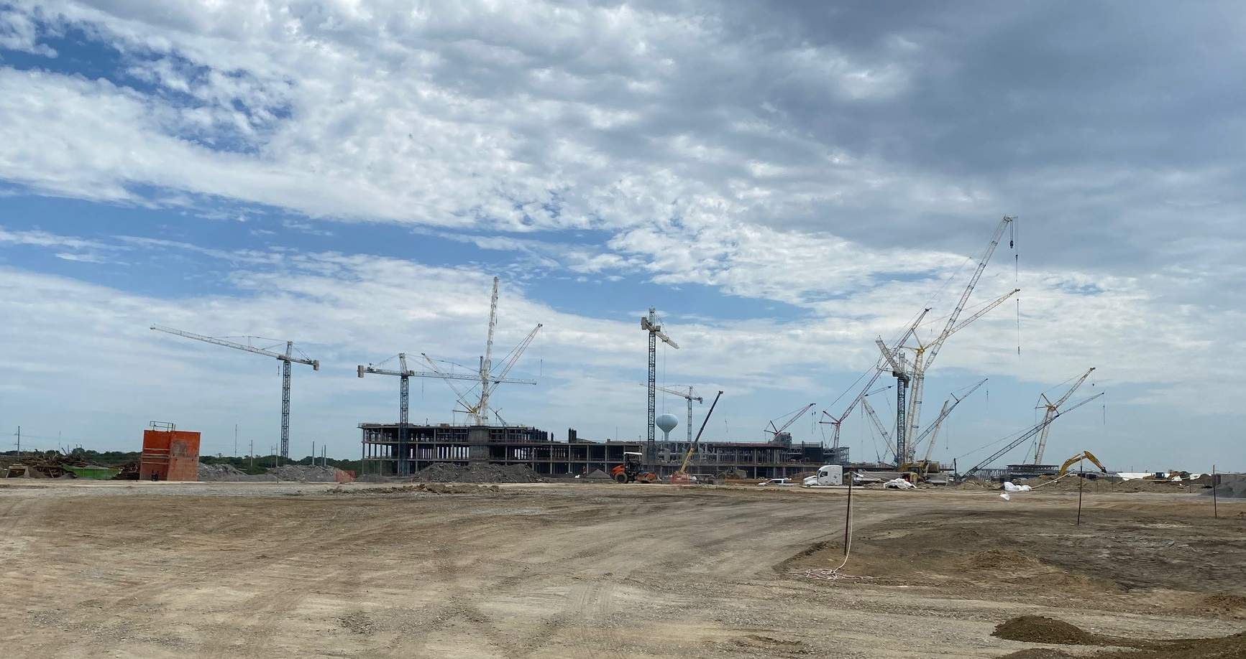
Semi-Conductor Plants
SM1/SM2 Semi-Conductor Plant
Sherman, Texas 16,300 Tons 764,200 SF

Slide 17
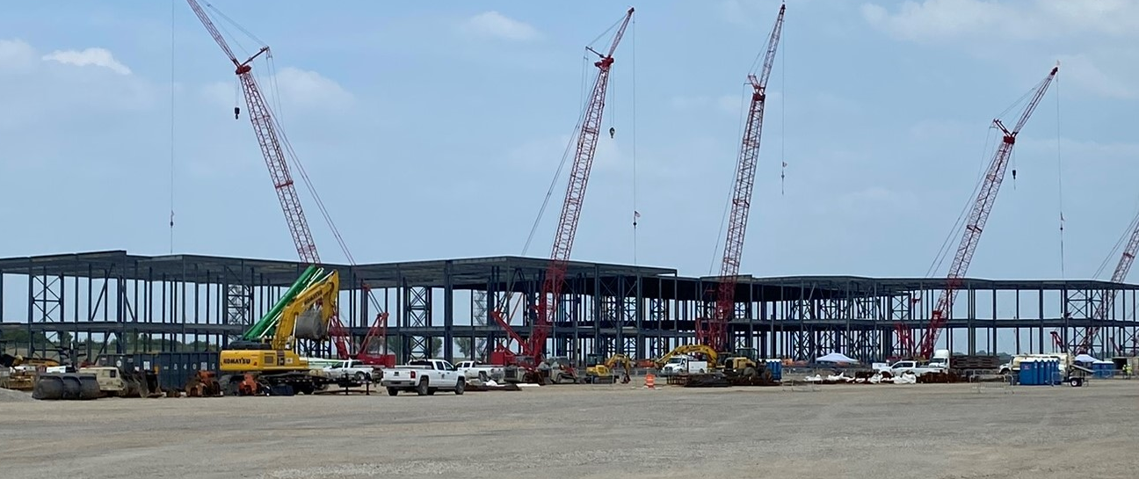
Battery Plants
Project Kansas
DeSoto, KS 73,000 Tons 5,477,000 SF

Slide 18
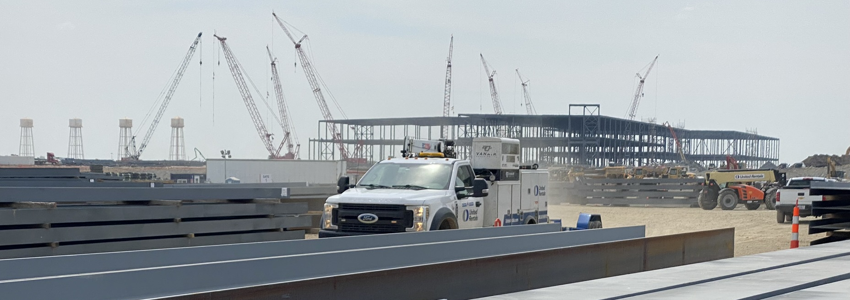
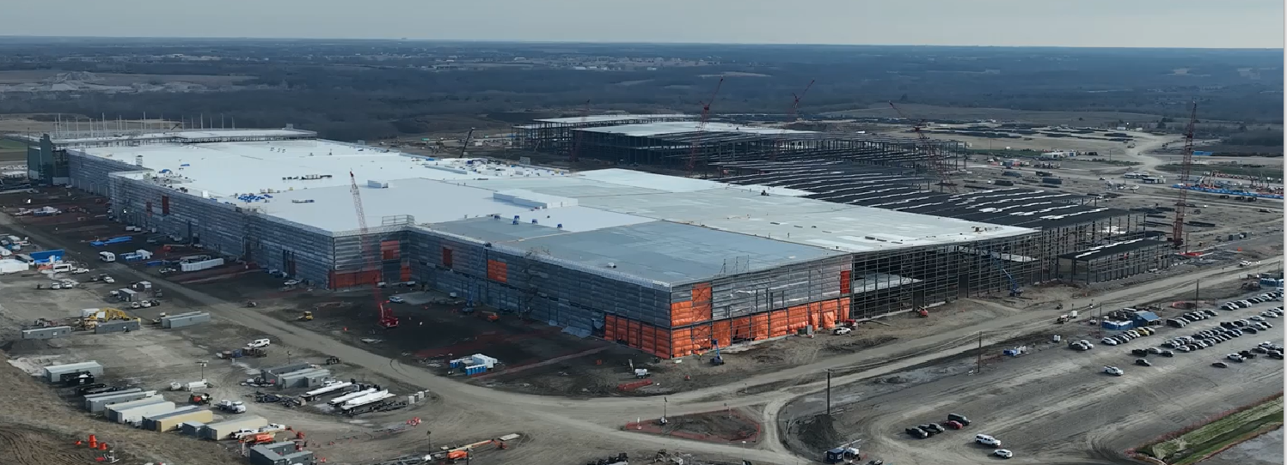
Battery Plants
Project Kansas
DeSoto, KS
73,000 Tons 5,477,000 SF

Slide 19
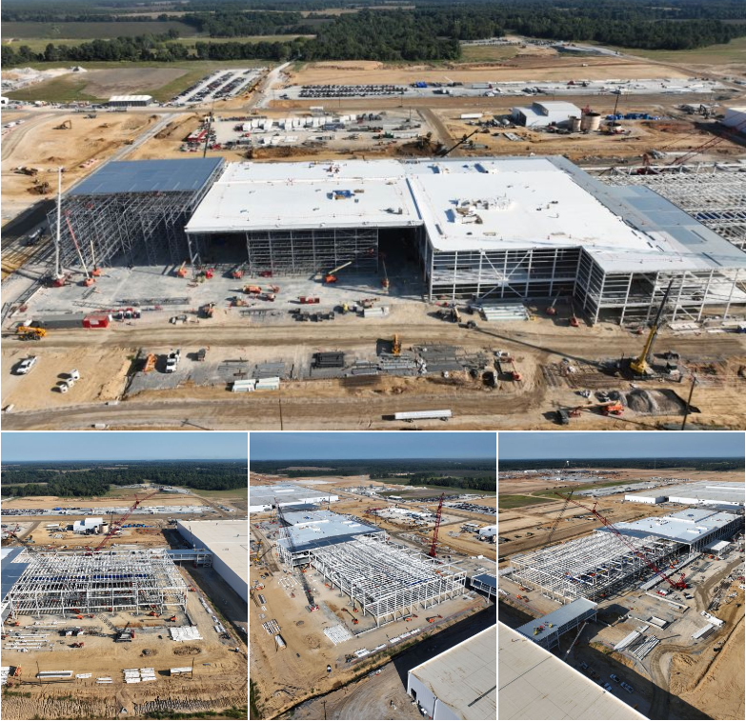
Electric Vehicle Plants
Ford Blue Oval Paint Shop
Stanton, TN
8,000 tons

Slide 20
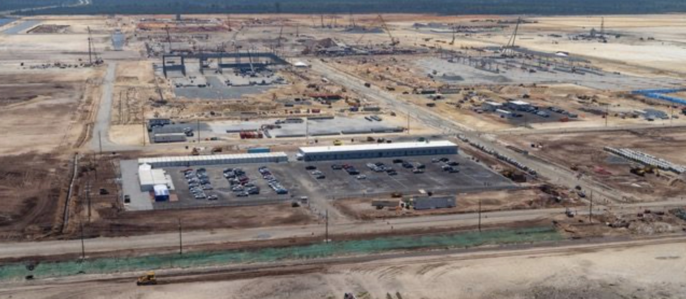
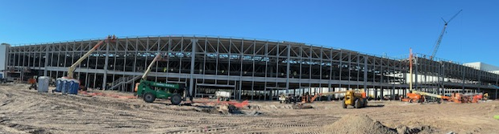
Electric Vehicle Plants
Hyundai Assembly Plant, Press Shop & Body Shop
Ellabell, GA 22,000 tons 1,857,000 SF

Slide 21
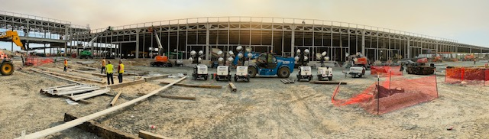
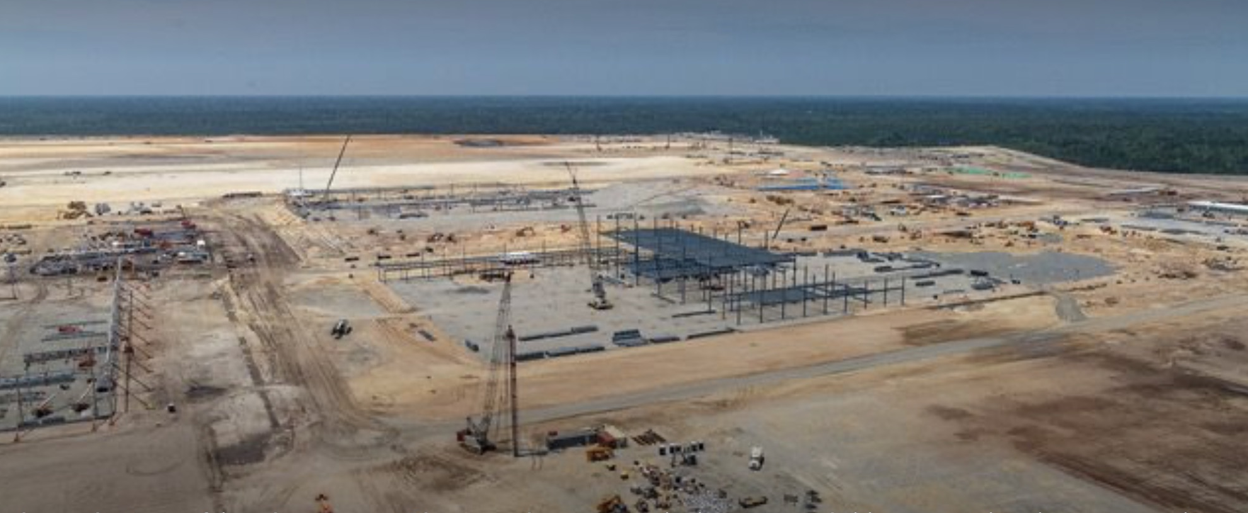
Electric Vehicle Plants
Hyundai Assembly Plant, Press Shop & Body Shop
Ellabell, GA 22,000 tons 1,857,000 SF

Slide 22
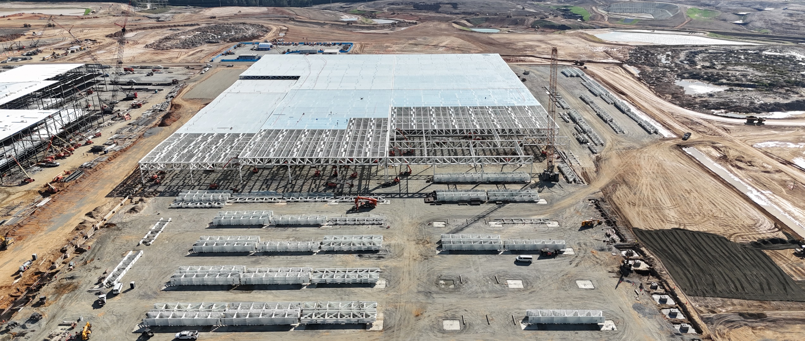
Electric Vehicle Plants
VW Scout - Body Bldg., Central Bldg. & Utility Bldg.
Blythewood, SC
19,300 tons 1.7 MIL SF

Slide 23
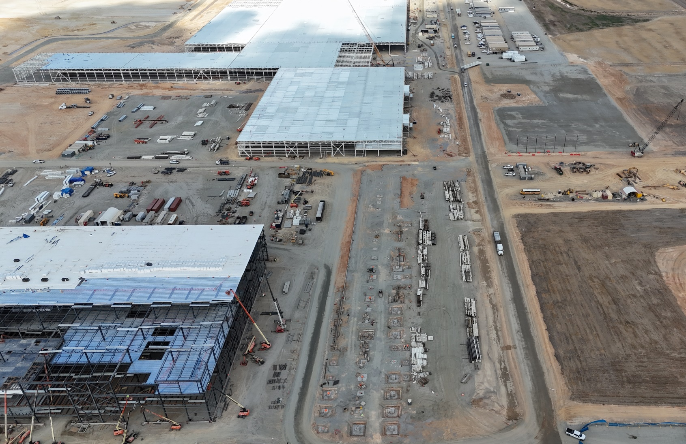
Electric Vehicle Plants
VW Scout - Body Bldg., Central Bldg. & Utility Bldg.
Blythewood, SC
19,300 tons 1.7 MIL SF

Slide 24
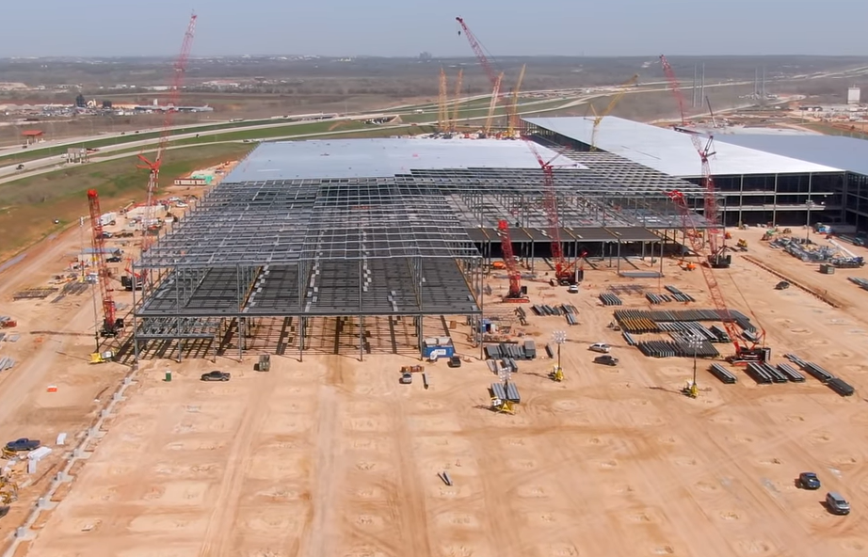
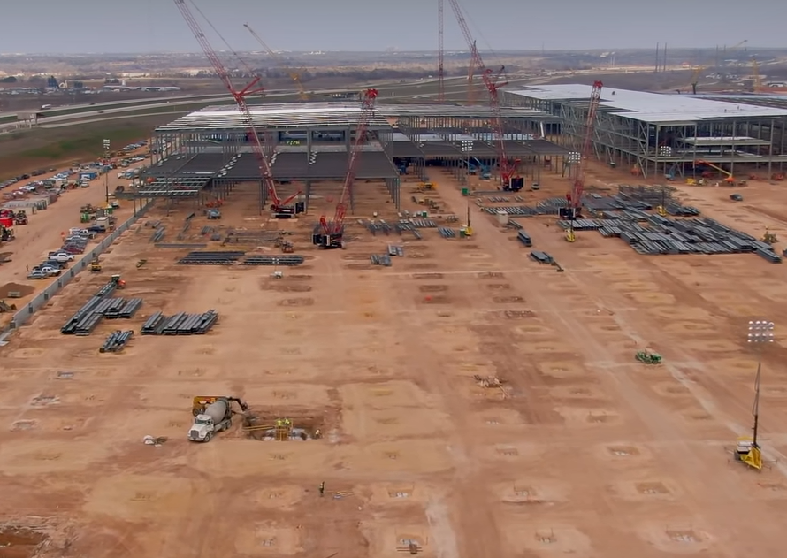
Electric Vehicle Plants
Tesla Assembly Plant – Austin, TX
36,000 Tons 1,600,000 SF

Slide 25
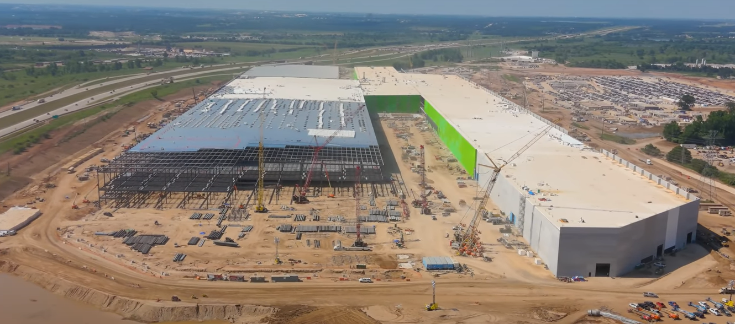
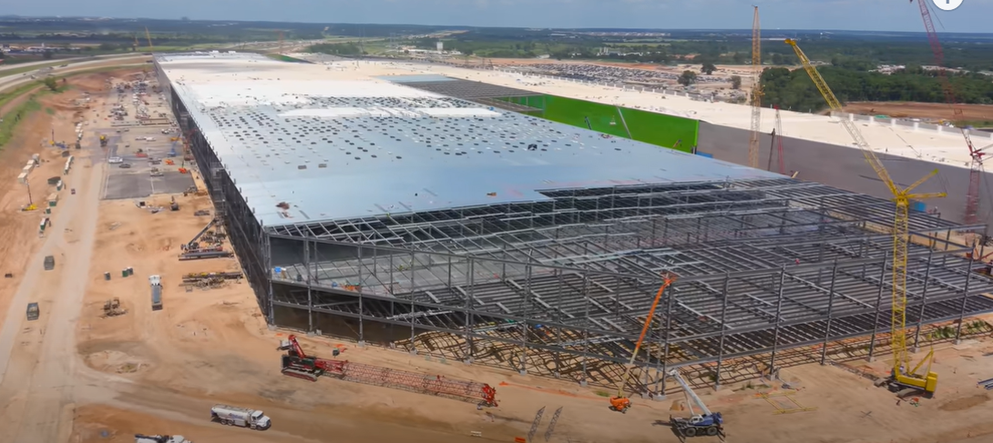
Electric Vehicle Plants
Tesla Assembly Plant
Austin, TX
36,000 Tons 1,600,000 SF

Slide 26
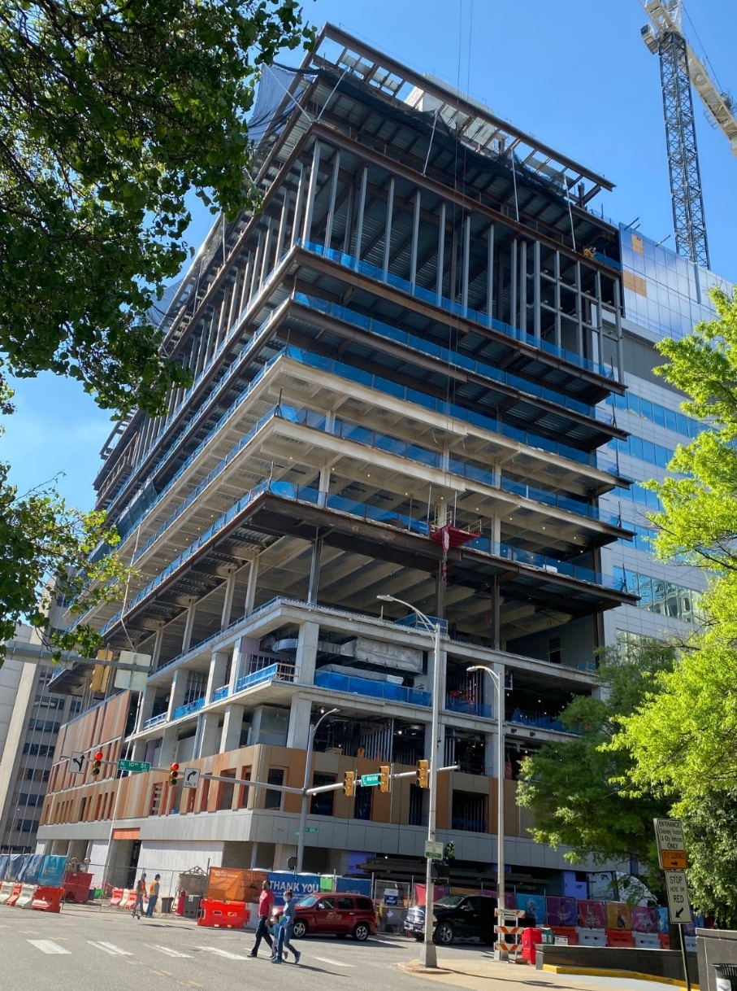
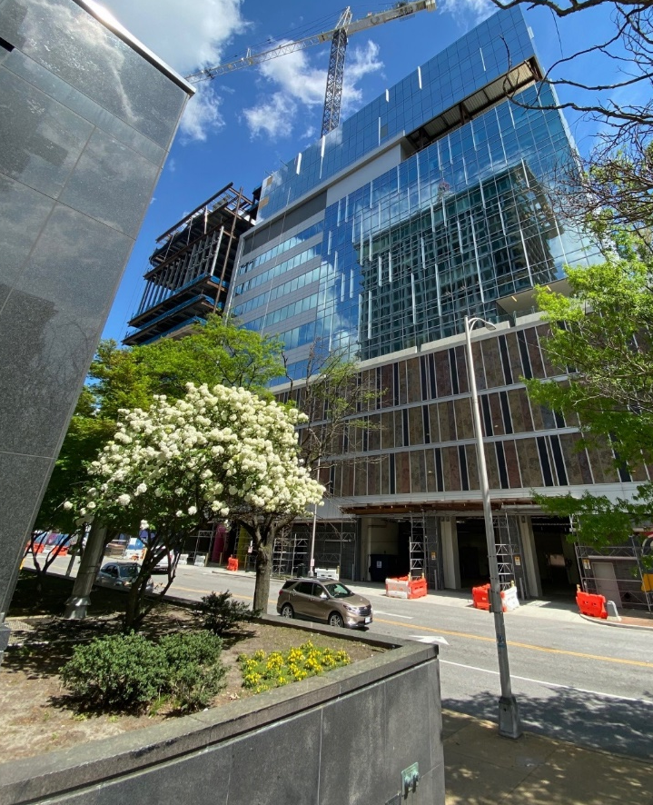
Healthcare
VCU Children’s Hospital Expansion
Richmond, VA 3,400 Tons
13-story tower, tied in at every level.
3-story vertical expansion of existing

Slide 27
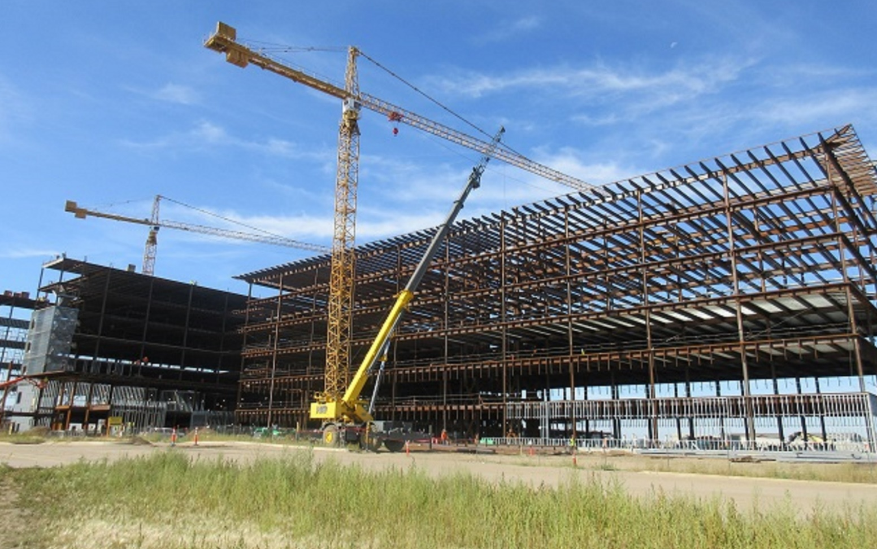
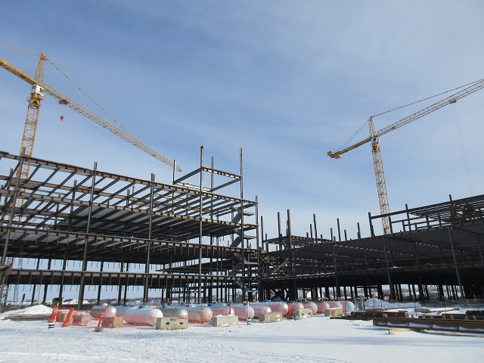
Healthcare
Trinity Hospital – Minot, ND 6,000 Tons

Slide 28
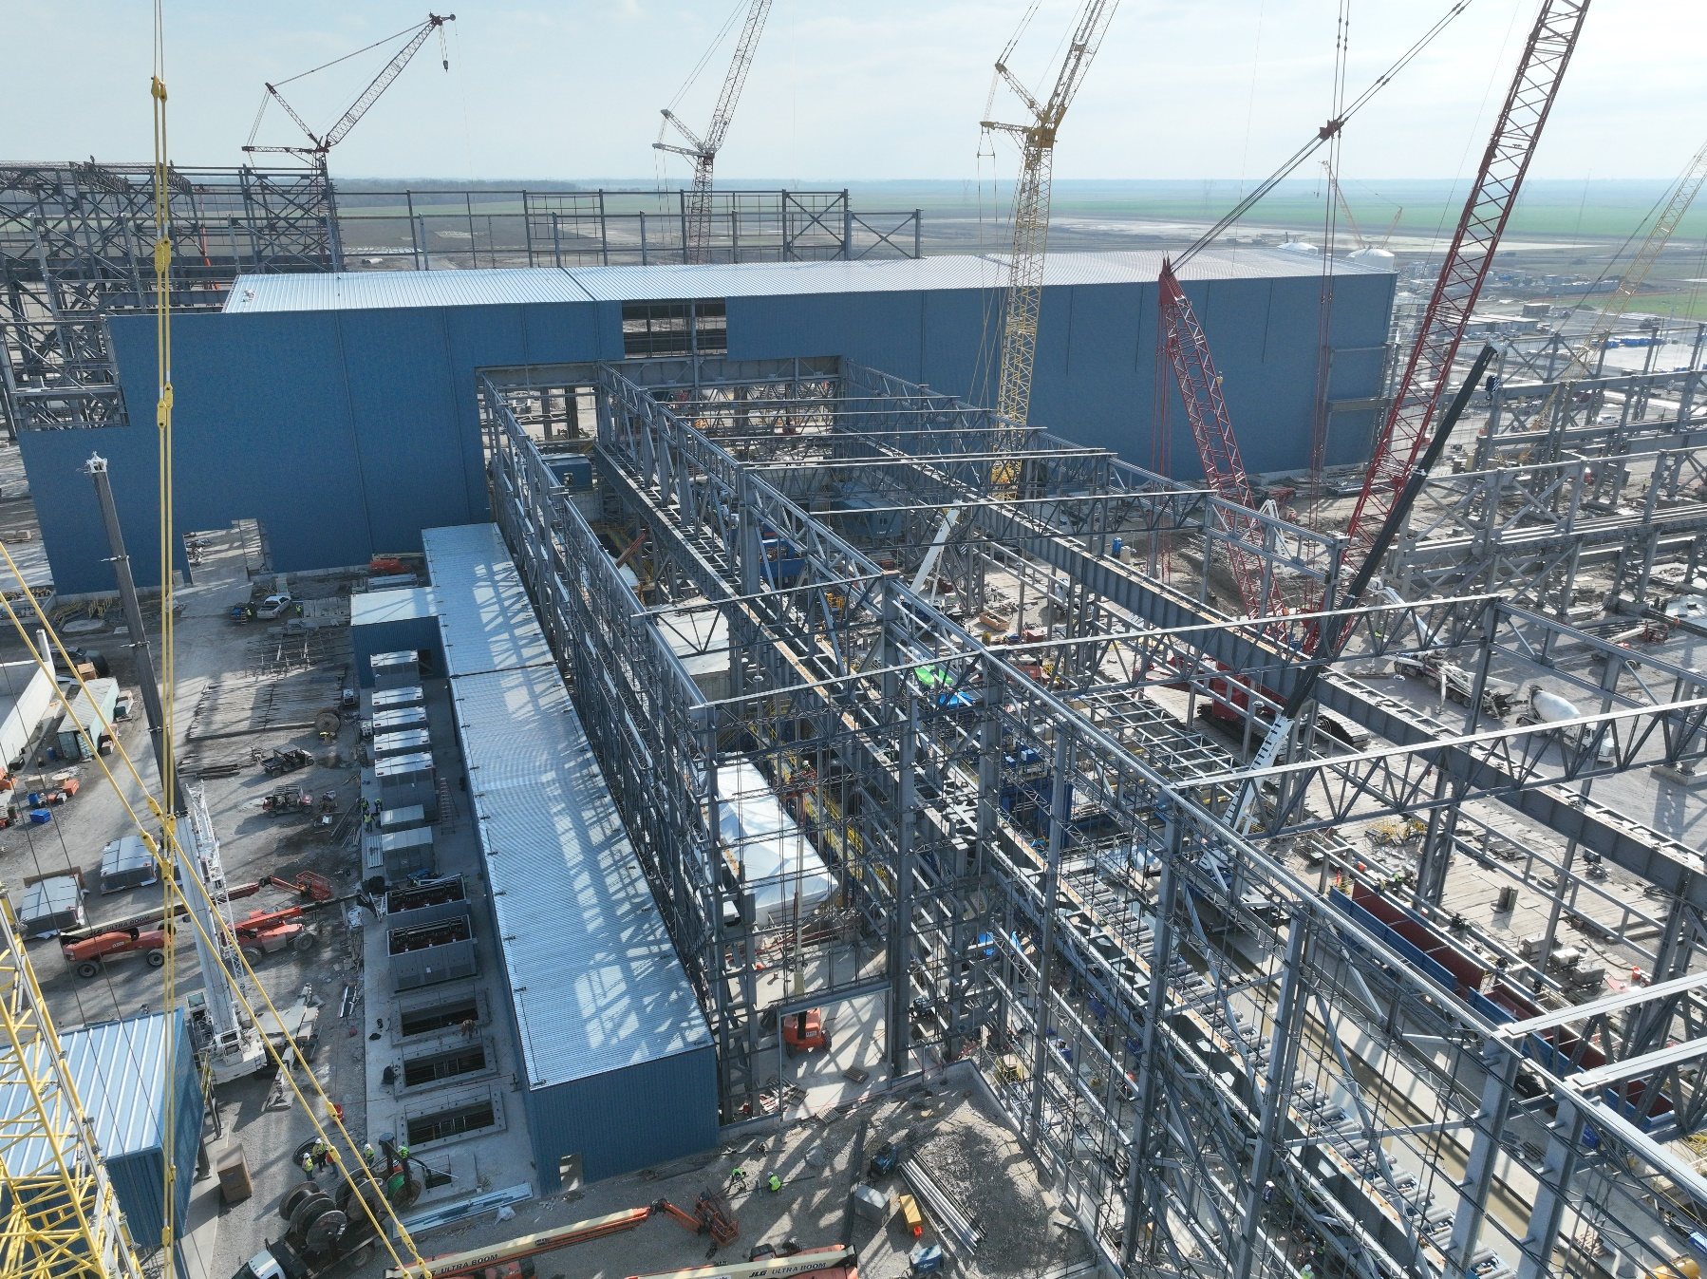
Steel Mills
Big River Steel Osceola, AR 24,000 tons

Slide 29
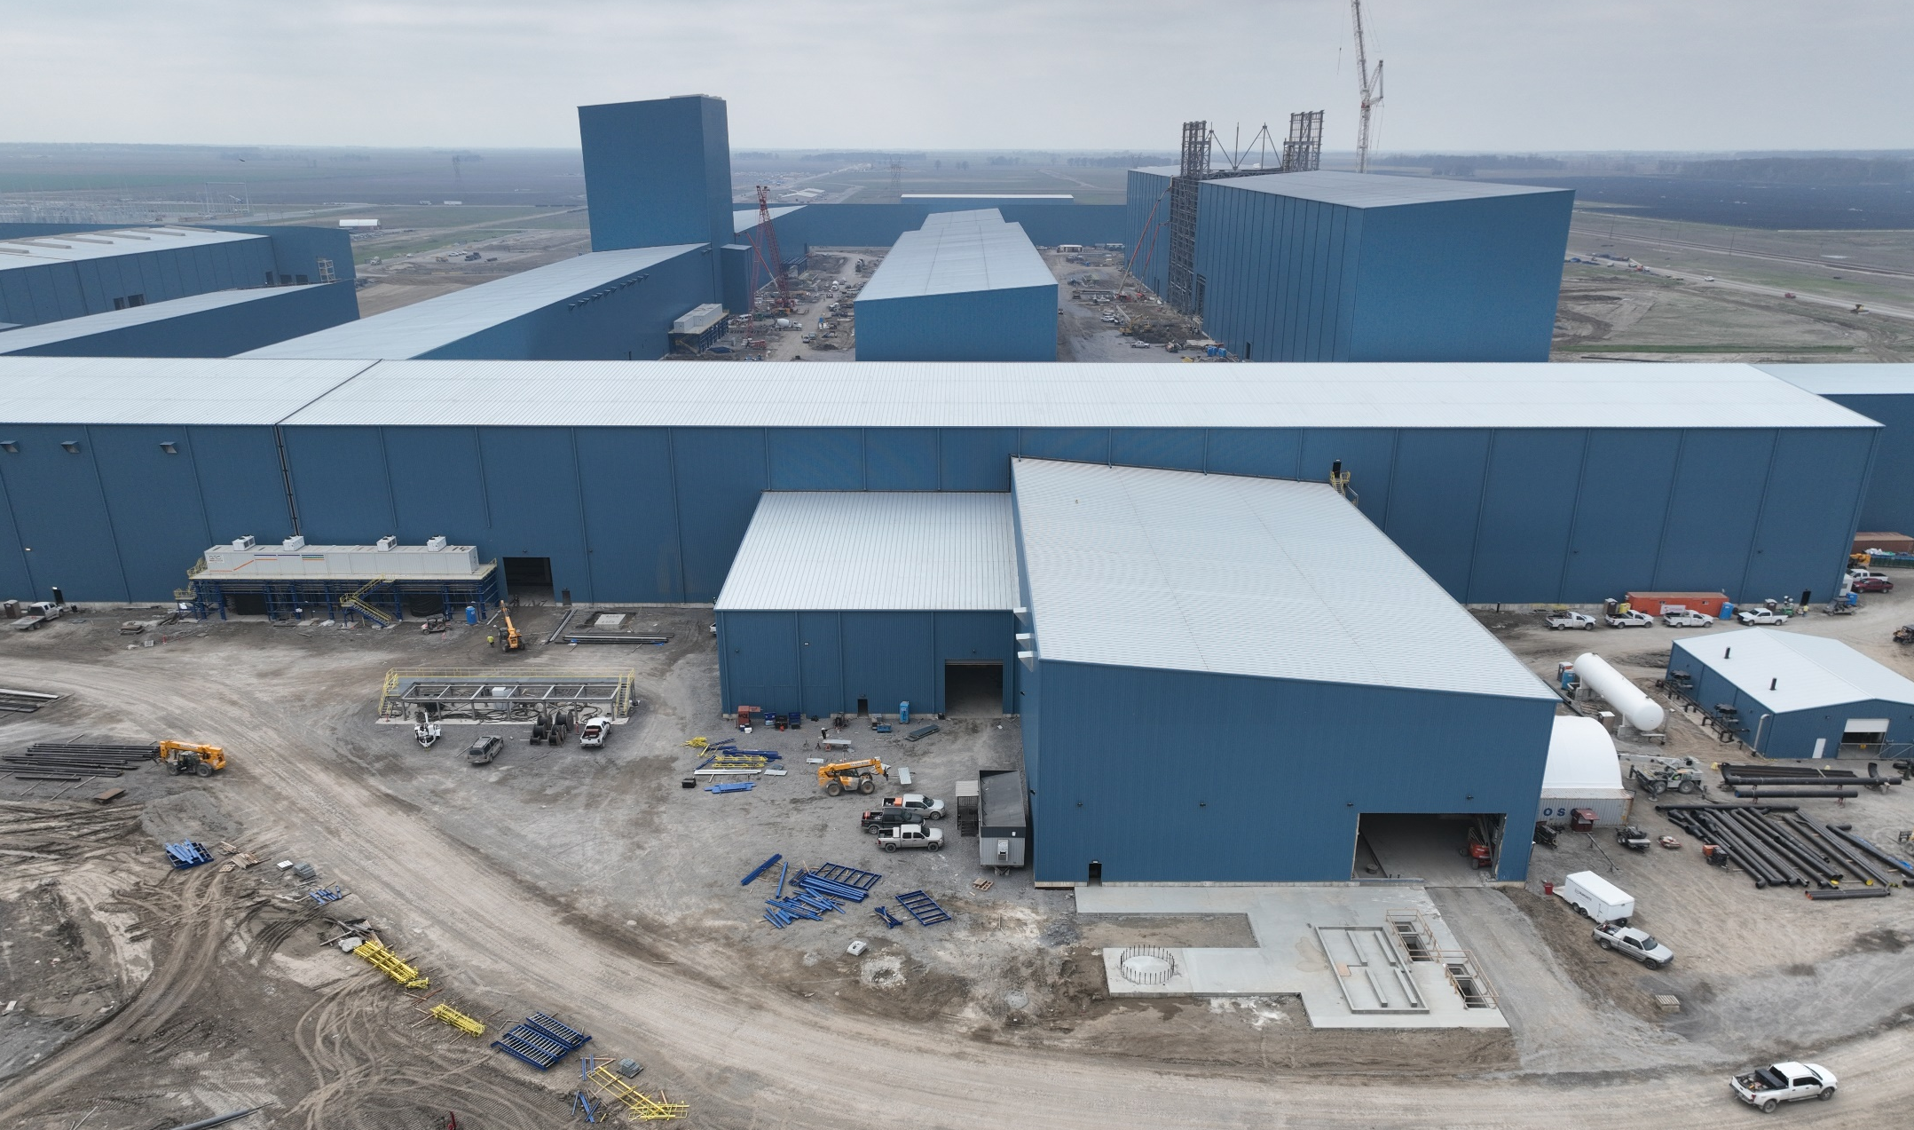
Steel Mills
Big River Steel Osceola, AR 24,000 tons

Slide 30
Major Work in Progress:
Apollo 11 GNE HS (Pharma Plant) Raleigh, NC 9,200 tons
Supermicro Mfg. San Jose, CA 3,500 tons
Serverfarm Data Center Hockley, TX 5,000 tons
QTS CDR DC 4-5 Data Centers Cedar Rapids, IA 10,200 tons
Project Hope (Semi-conductor) Peoria, AZ 45,000 tons
AWS IAD 452 Data Center Spotsylvania, VA 2,200 tons
AWS CMH 170 Data Center Marysville, OH 1,600 tons
Switch RNO Bldg. 5 Data Center Reno, NV 5,700 tons
SDC Blackfin/Bluefin Data Centers Ashburn, VA 23,100 tons
Meta Project 10X Data Centers Holly Ridge, LA 14,600 tons
EdgeConneX Data Centers New Albany, OH 8,500 tons
Austin Convention Center Austin, TX 16,000 tons

Slide 31
Thank you.

